Slide 1

EDA on Google Play Store data
Analysis
Attributes
Objective
About
PROJECT – Term 1 & 2
Submitted By SHAILEE DWARKANI

Slide 2






Dataset Selection
Analysis
Browsed through multiple datasets
Shortlisted based on available attributes
Selected this dataset as it had scope of deriving good insights
Identified initial correlations
Shortlisted attributes with insights
Analysis on shortlisted attributes
Analyzed on sub datasets
Data Profiling
Conclusion
Analysis
Attributes
Objective
Profiling indicated need of cleaning and standardizing some attributes
Special characters in numerical attributes
Duplicate rows and missing values
Derived good insights based on above analysis
The insights could be used to deliver business value
About
Data Processing
Presentation
Standardized all numerical attributes
Removed duplicate rows, filled missing values
Converted few continuous attributes to categorical for better analysis
Created new attribute (Revenue)
Designed presentation based on look and feel of selected dataset
Updated graphs to match with the presentation
Summarized presentation for management

Slide 3



NEW APP DEVELOPMENT
Analysis
Attributes
Objective
About
Customary
Unexplored
Subscription
Identify App attributes for regular sectors – high demand and high availability
Identify App attributes for unexplored sectors – high demand but less availability
Identify App attributes for subscription sectors – users ready to pay for app services

Slide 4
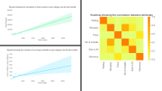
10 K
Category
Genre
Size
Content
Price
Installs
Average Rating
Reviews
Analysis
Attributes
About
No major impact of Ratings, most ratings lie in highest band
No of reviews show a positive correlation with no of installs
Availability of more apps in each category shows a slight correlation with the no of installs

Slide 5





Category
Genre
Size
Content
Price
1
2
3
4
5
Based on
Based on
Based on
Based on
Based on
Analysis
Attributes
About
Availability
Installs
Reviews
Revenue
Availability
Installs
Reviews
Revenue
Availability
Installs
Reviews
Revenue
Availability
Installs
Reviews
Revenue
Availability
Installs
Revenue

Slide 6
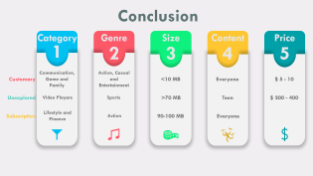
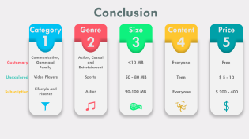
Category
Genre
Size
Analysis
Attributes
About
Content
Price

Slide 7
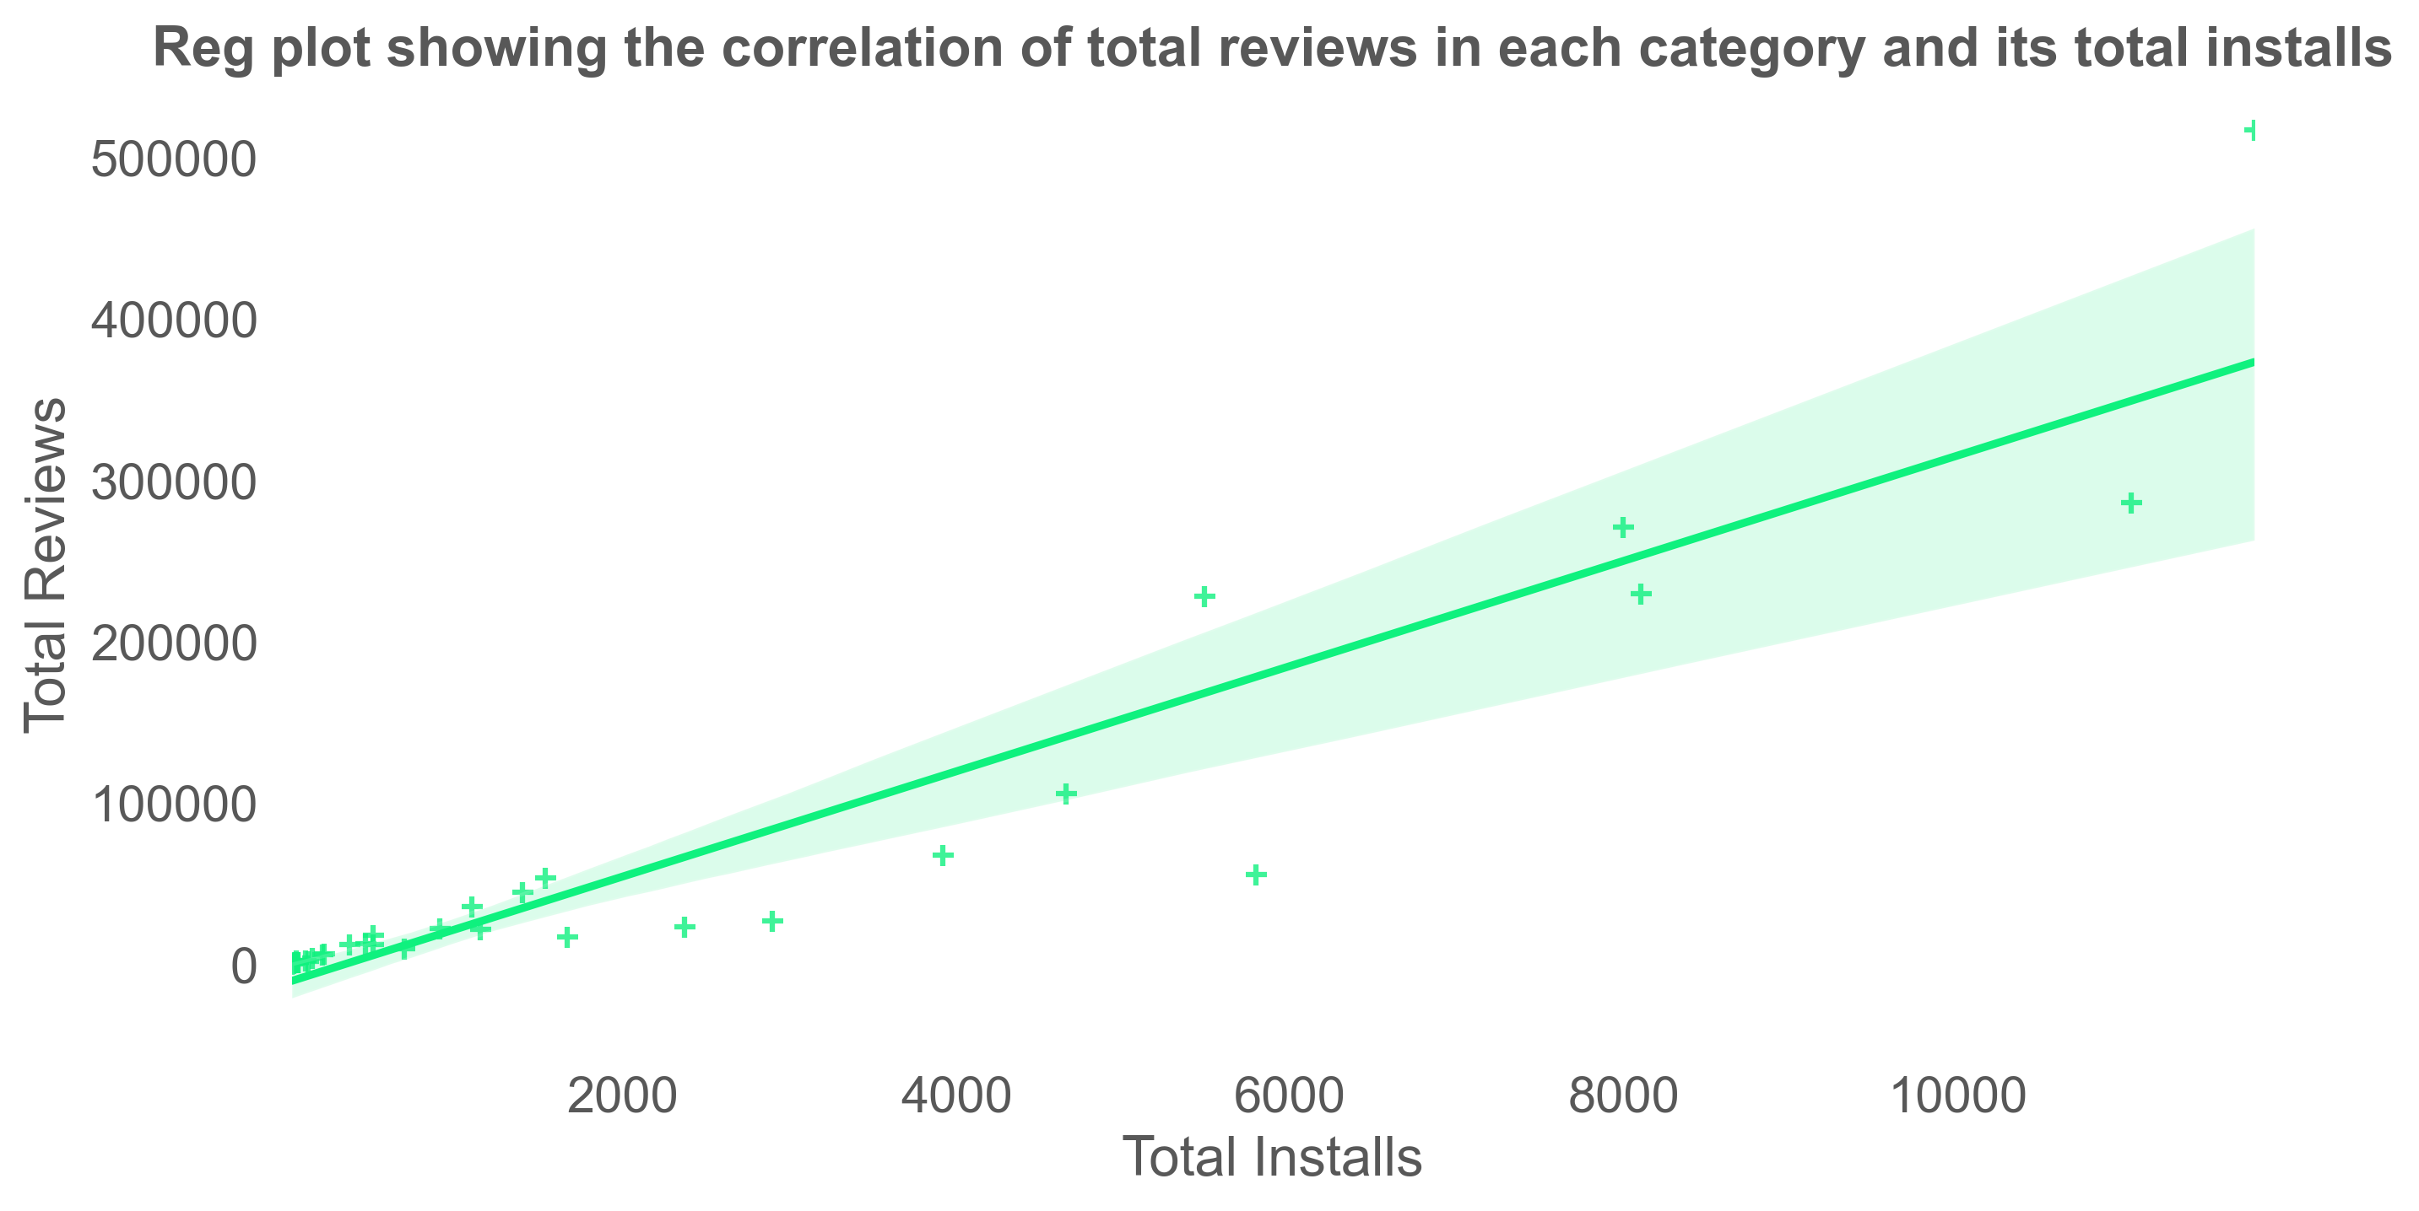
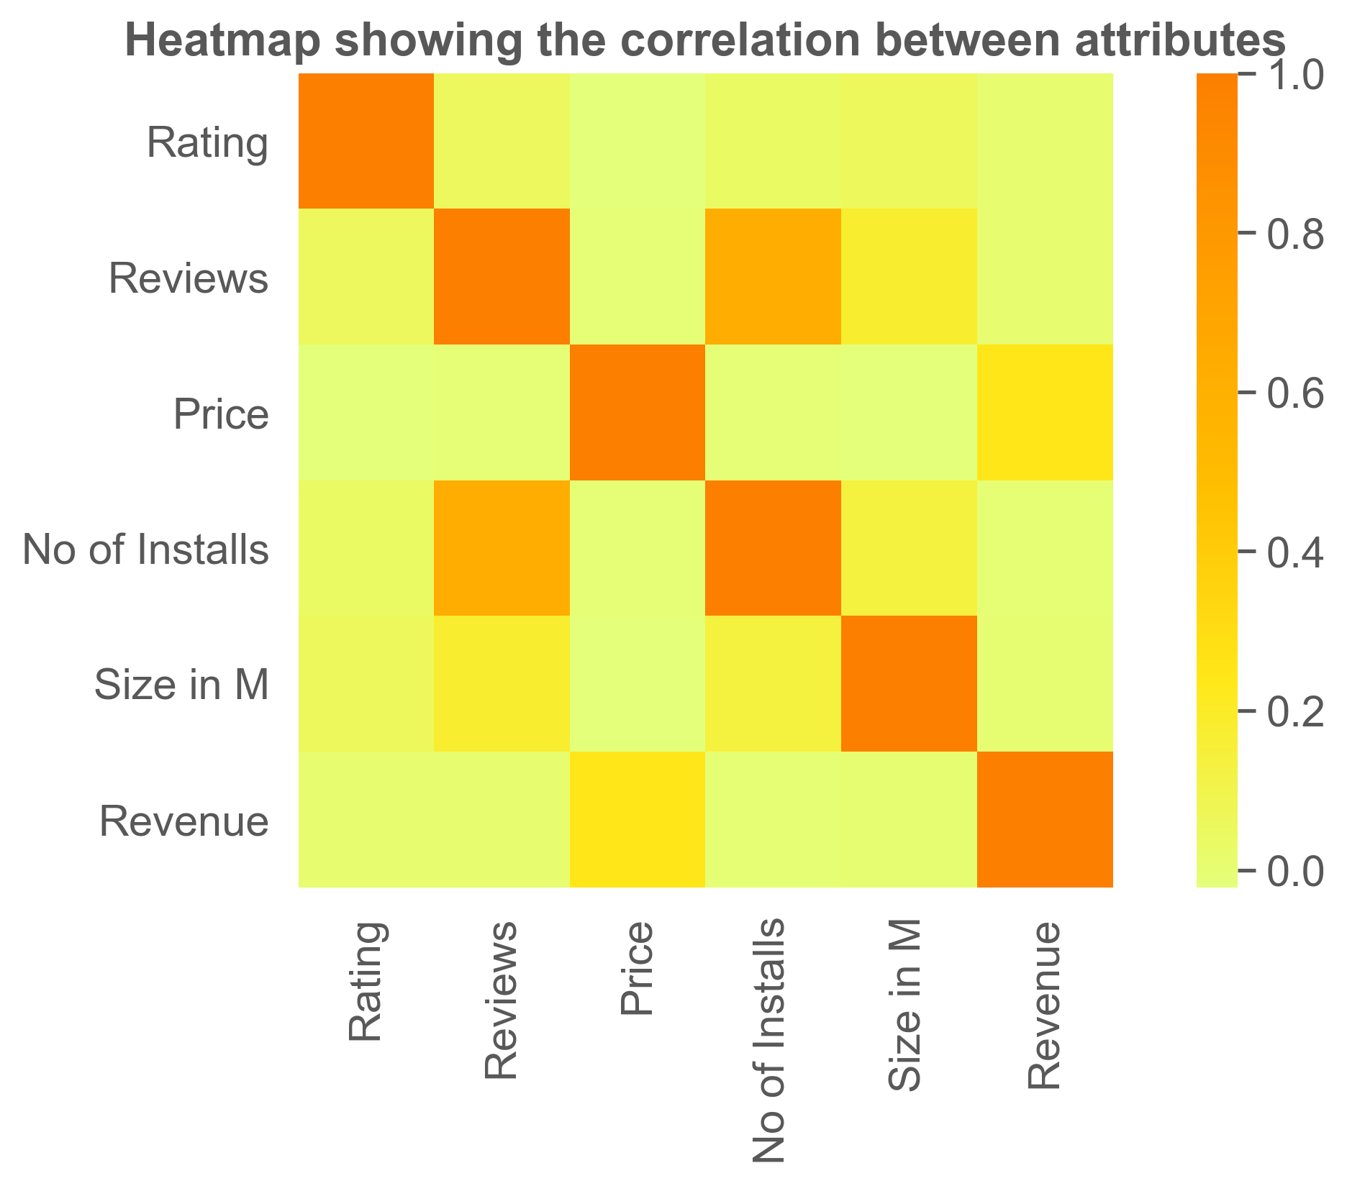
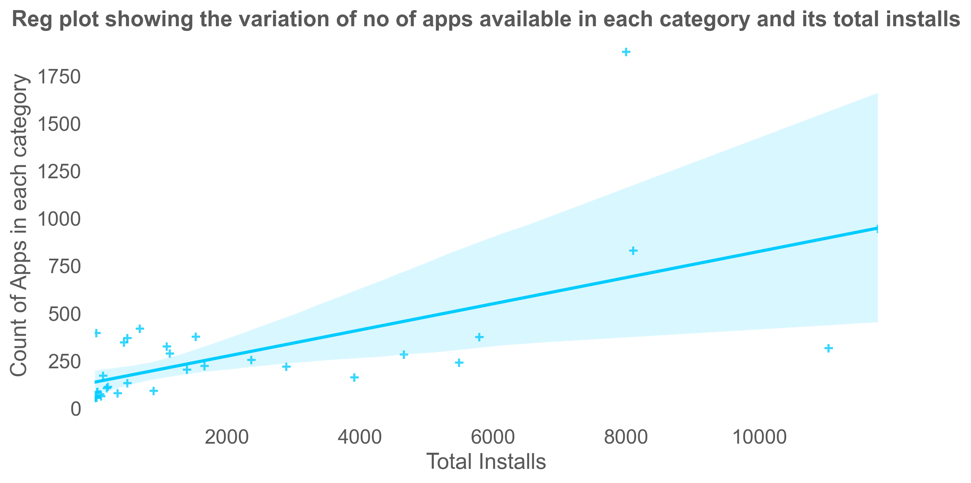

Slide 8
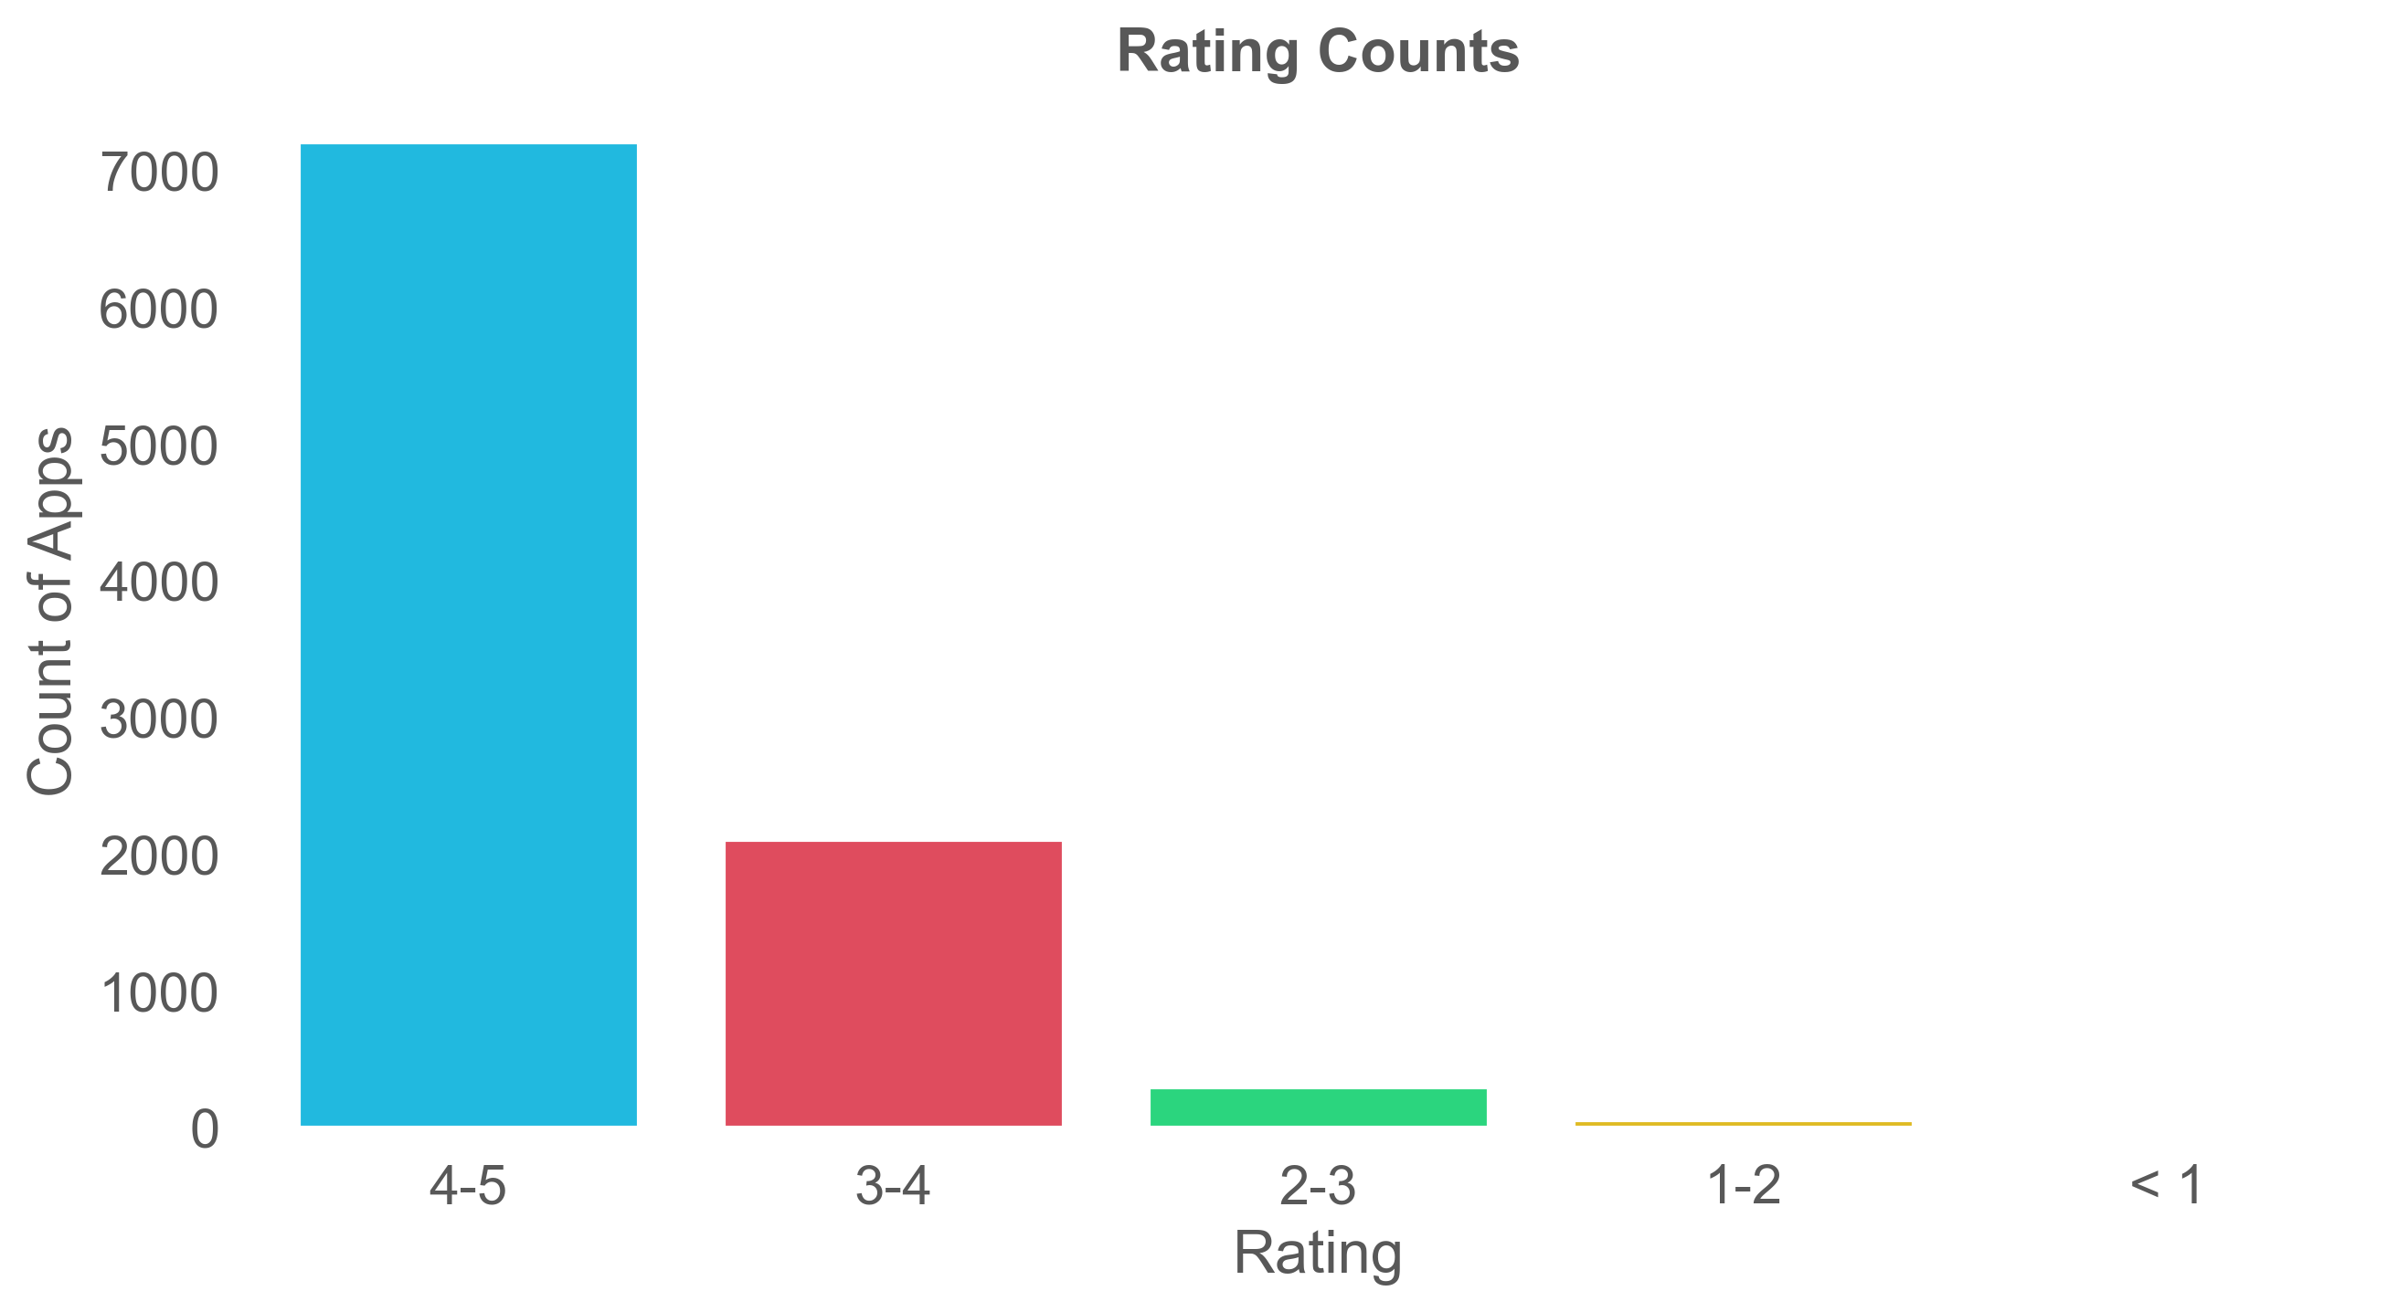
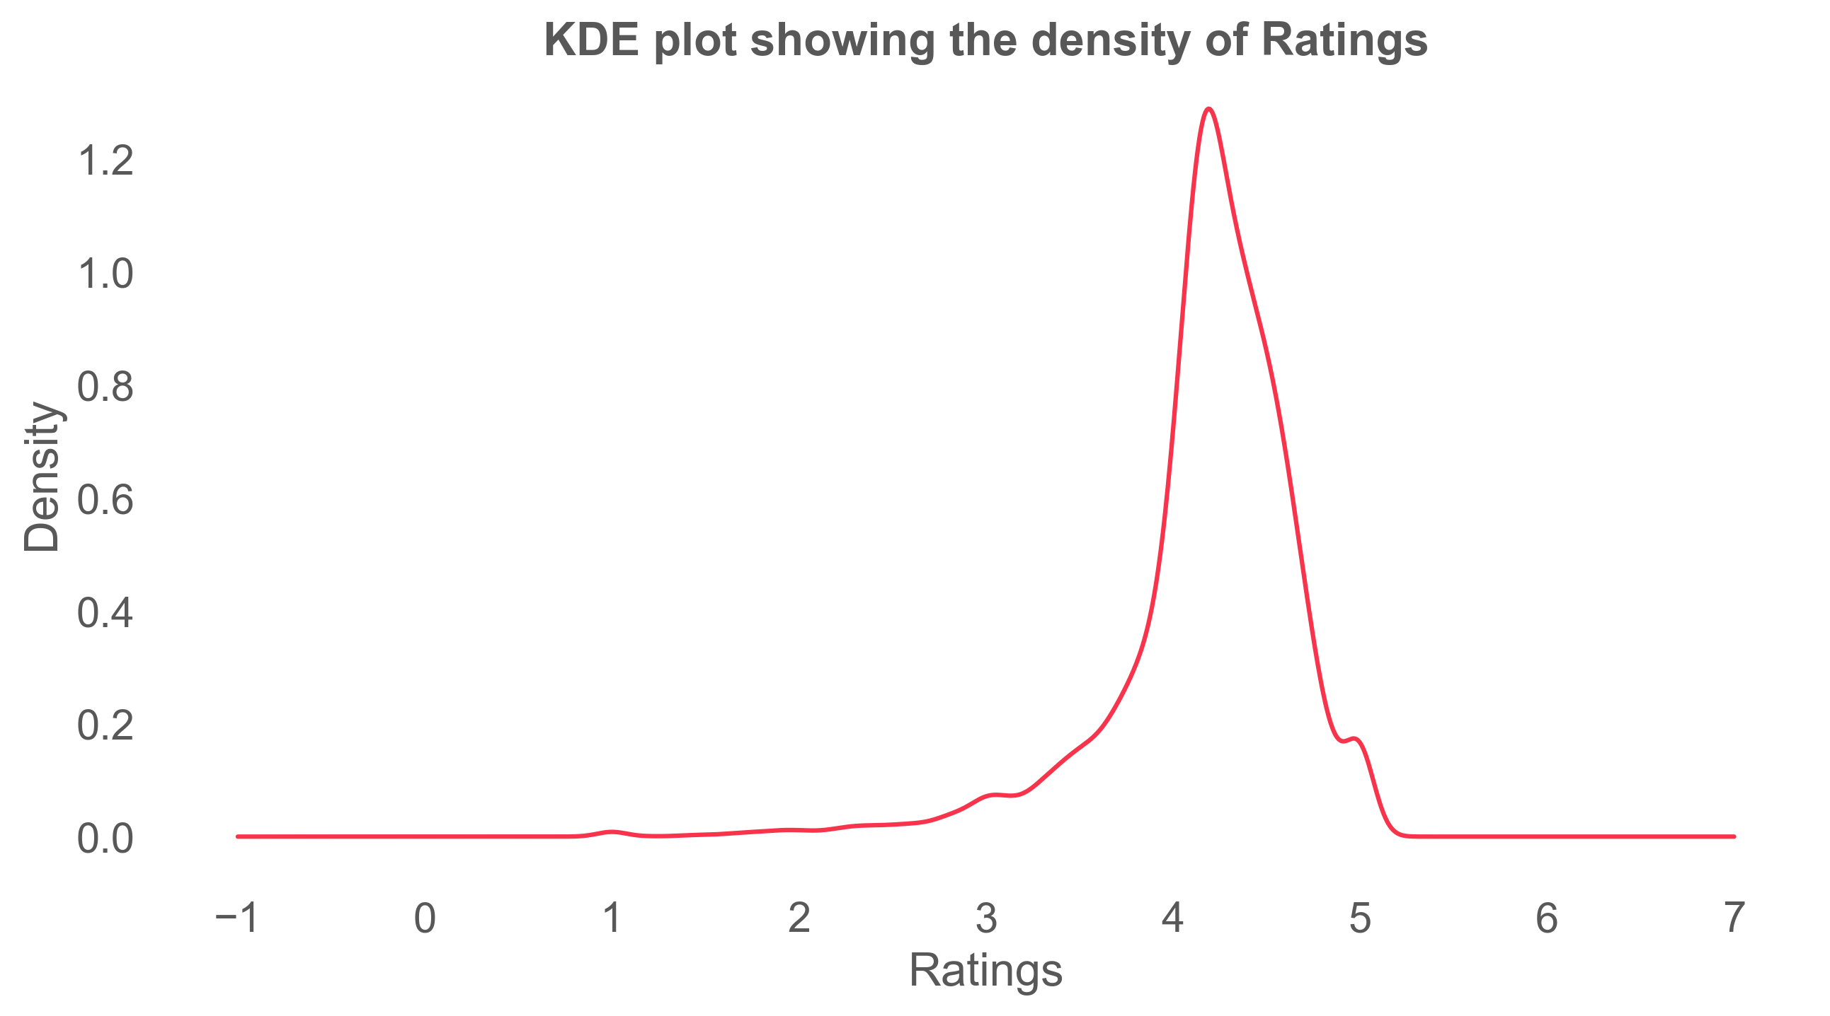

Slide 9
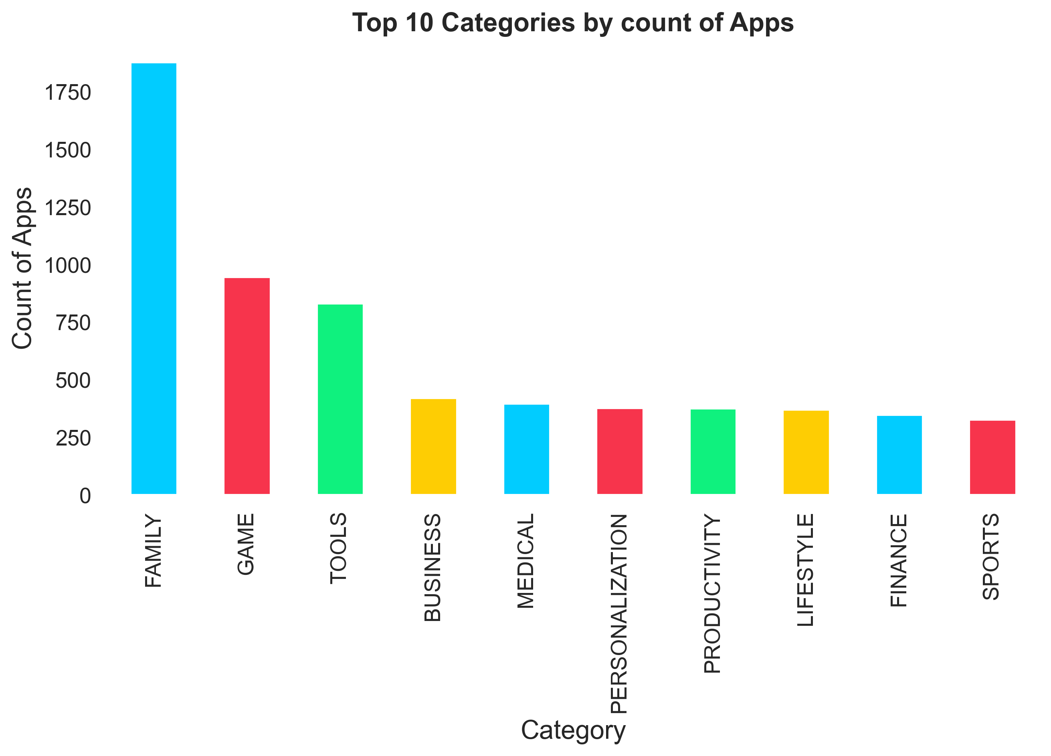
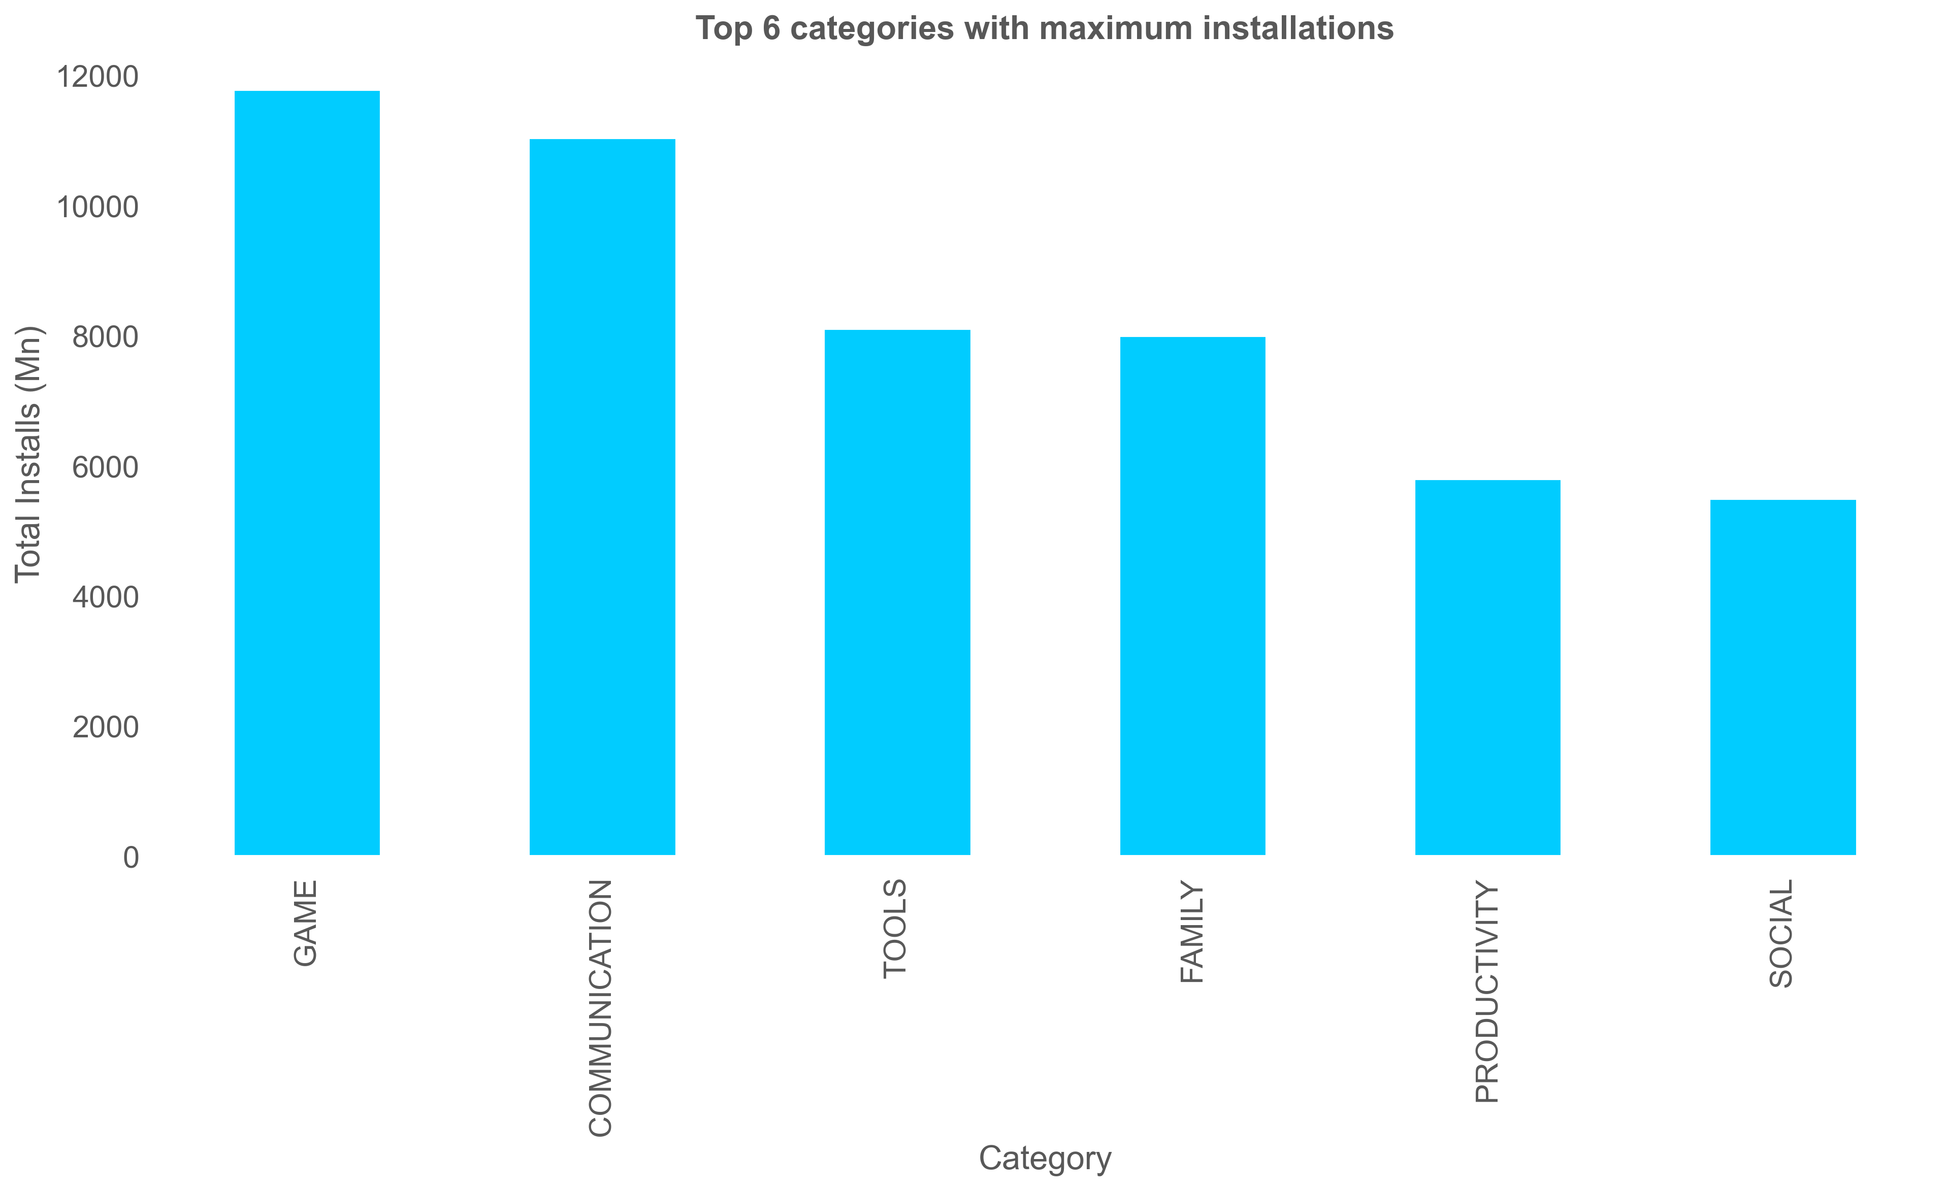
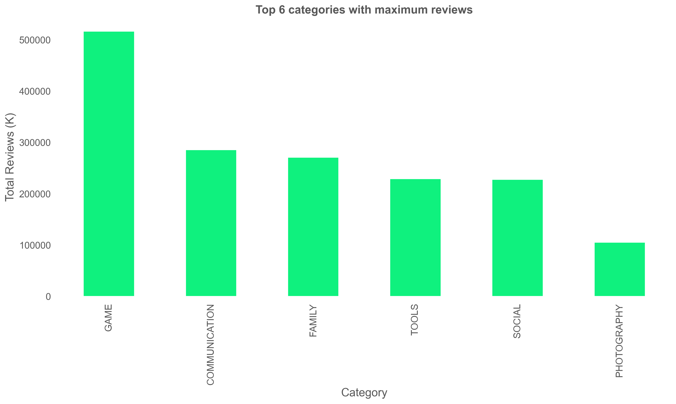
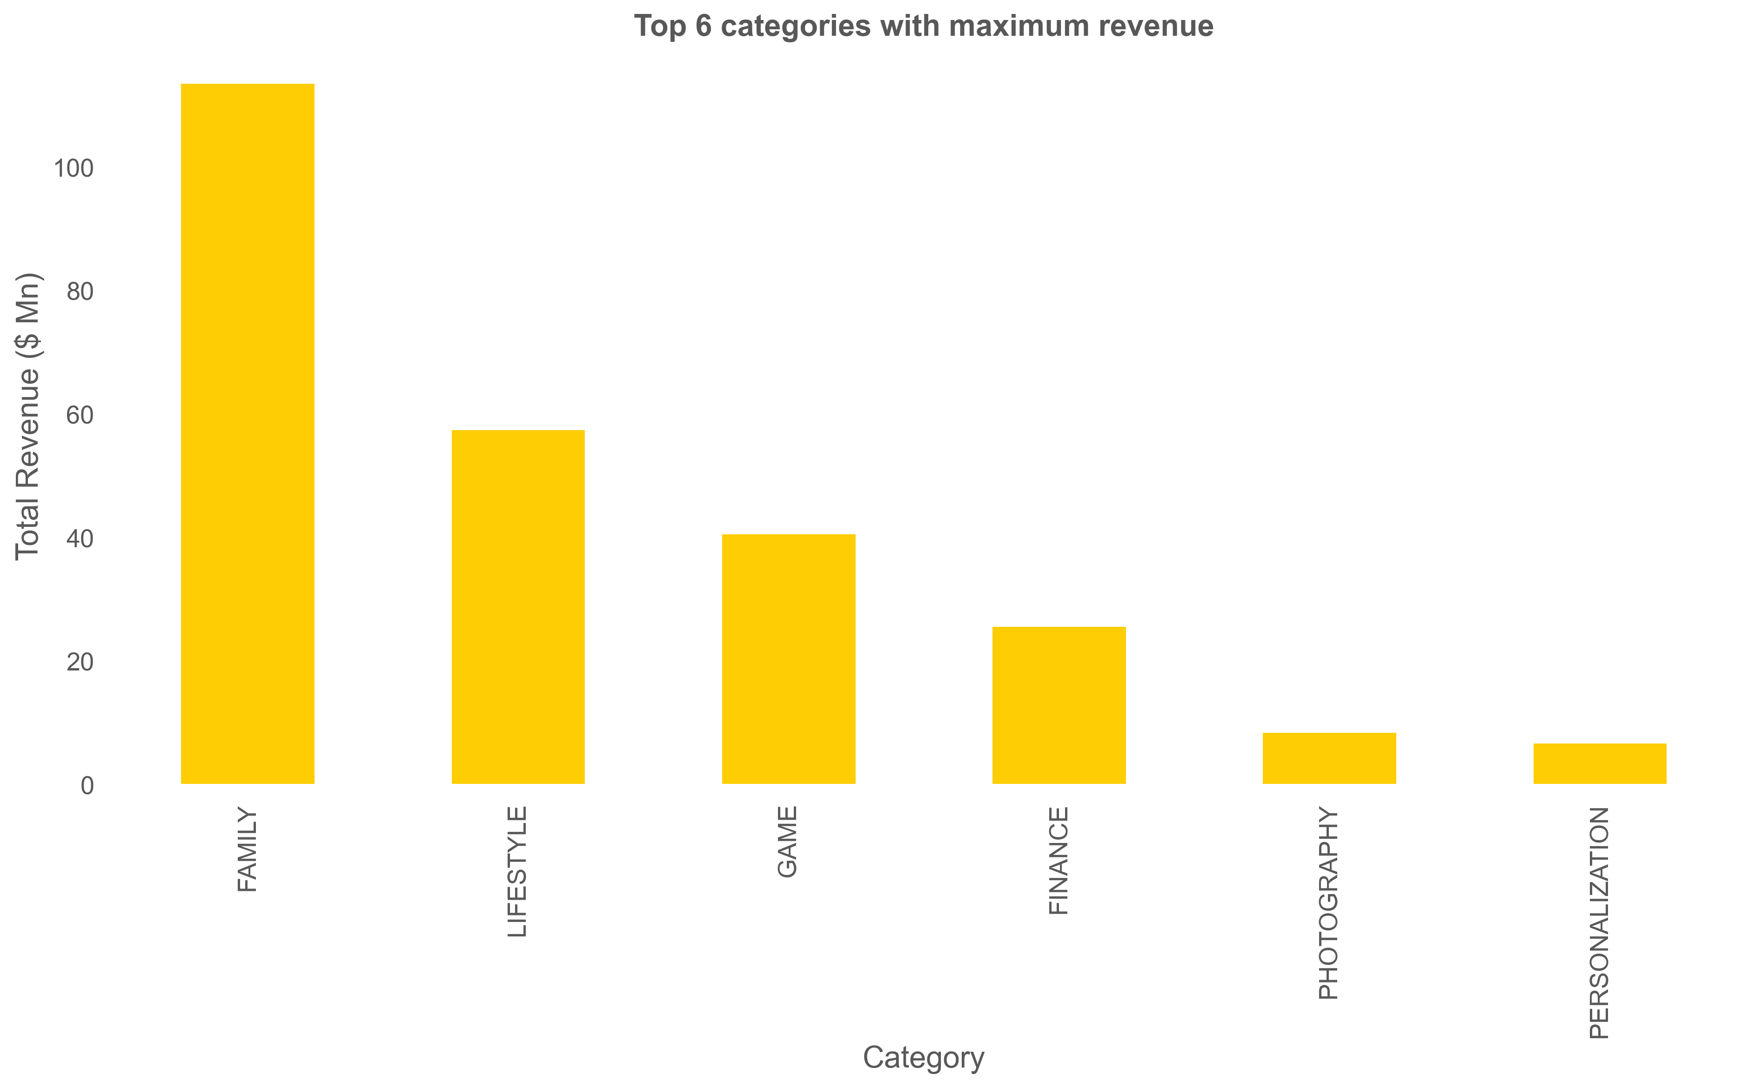

Slide 10
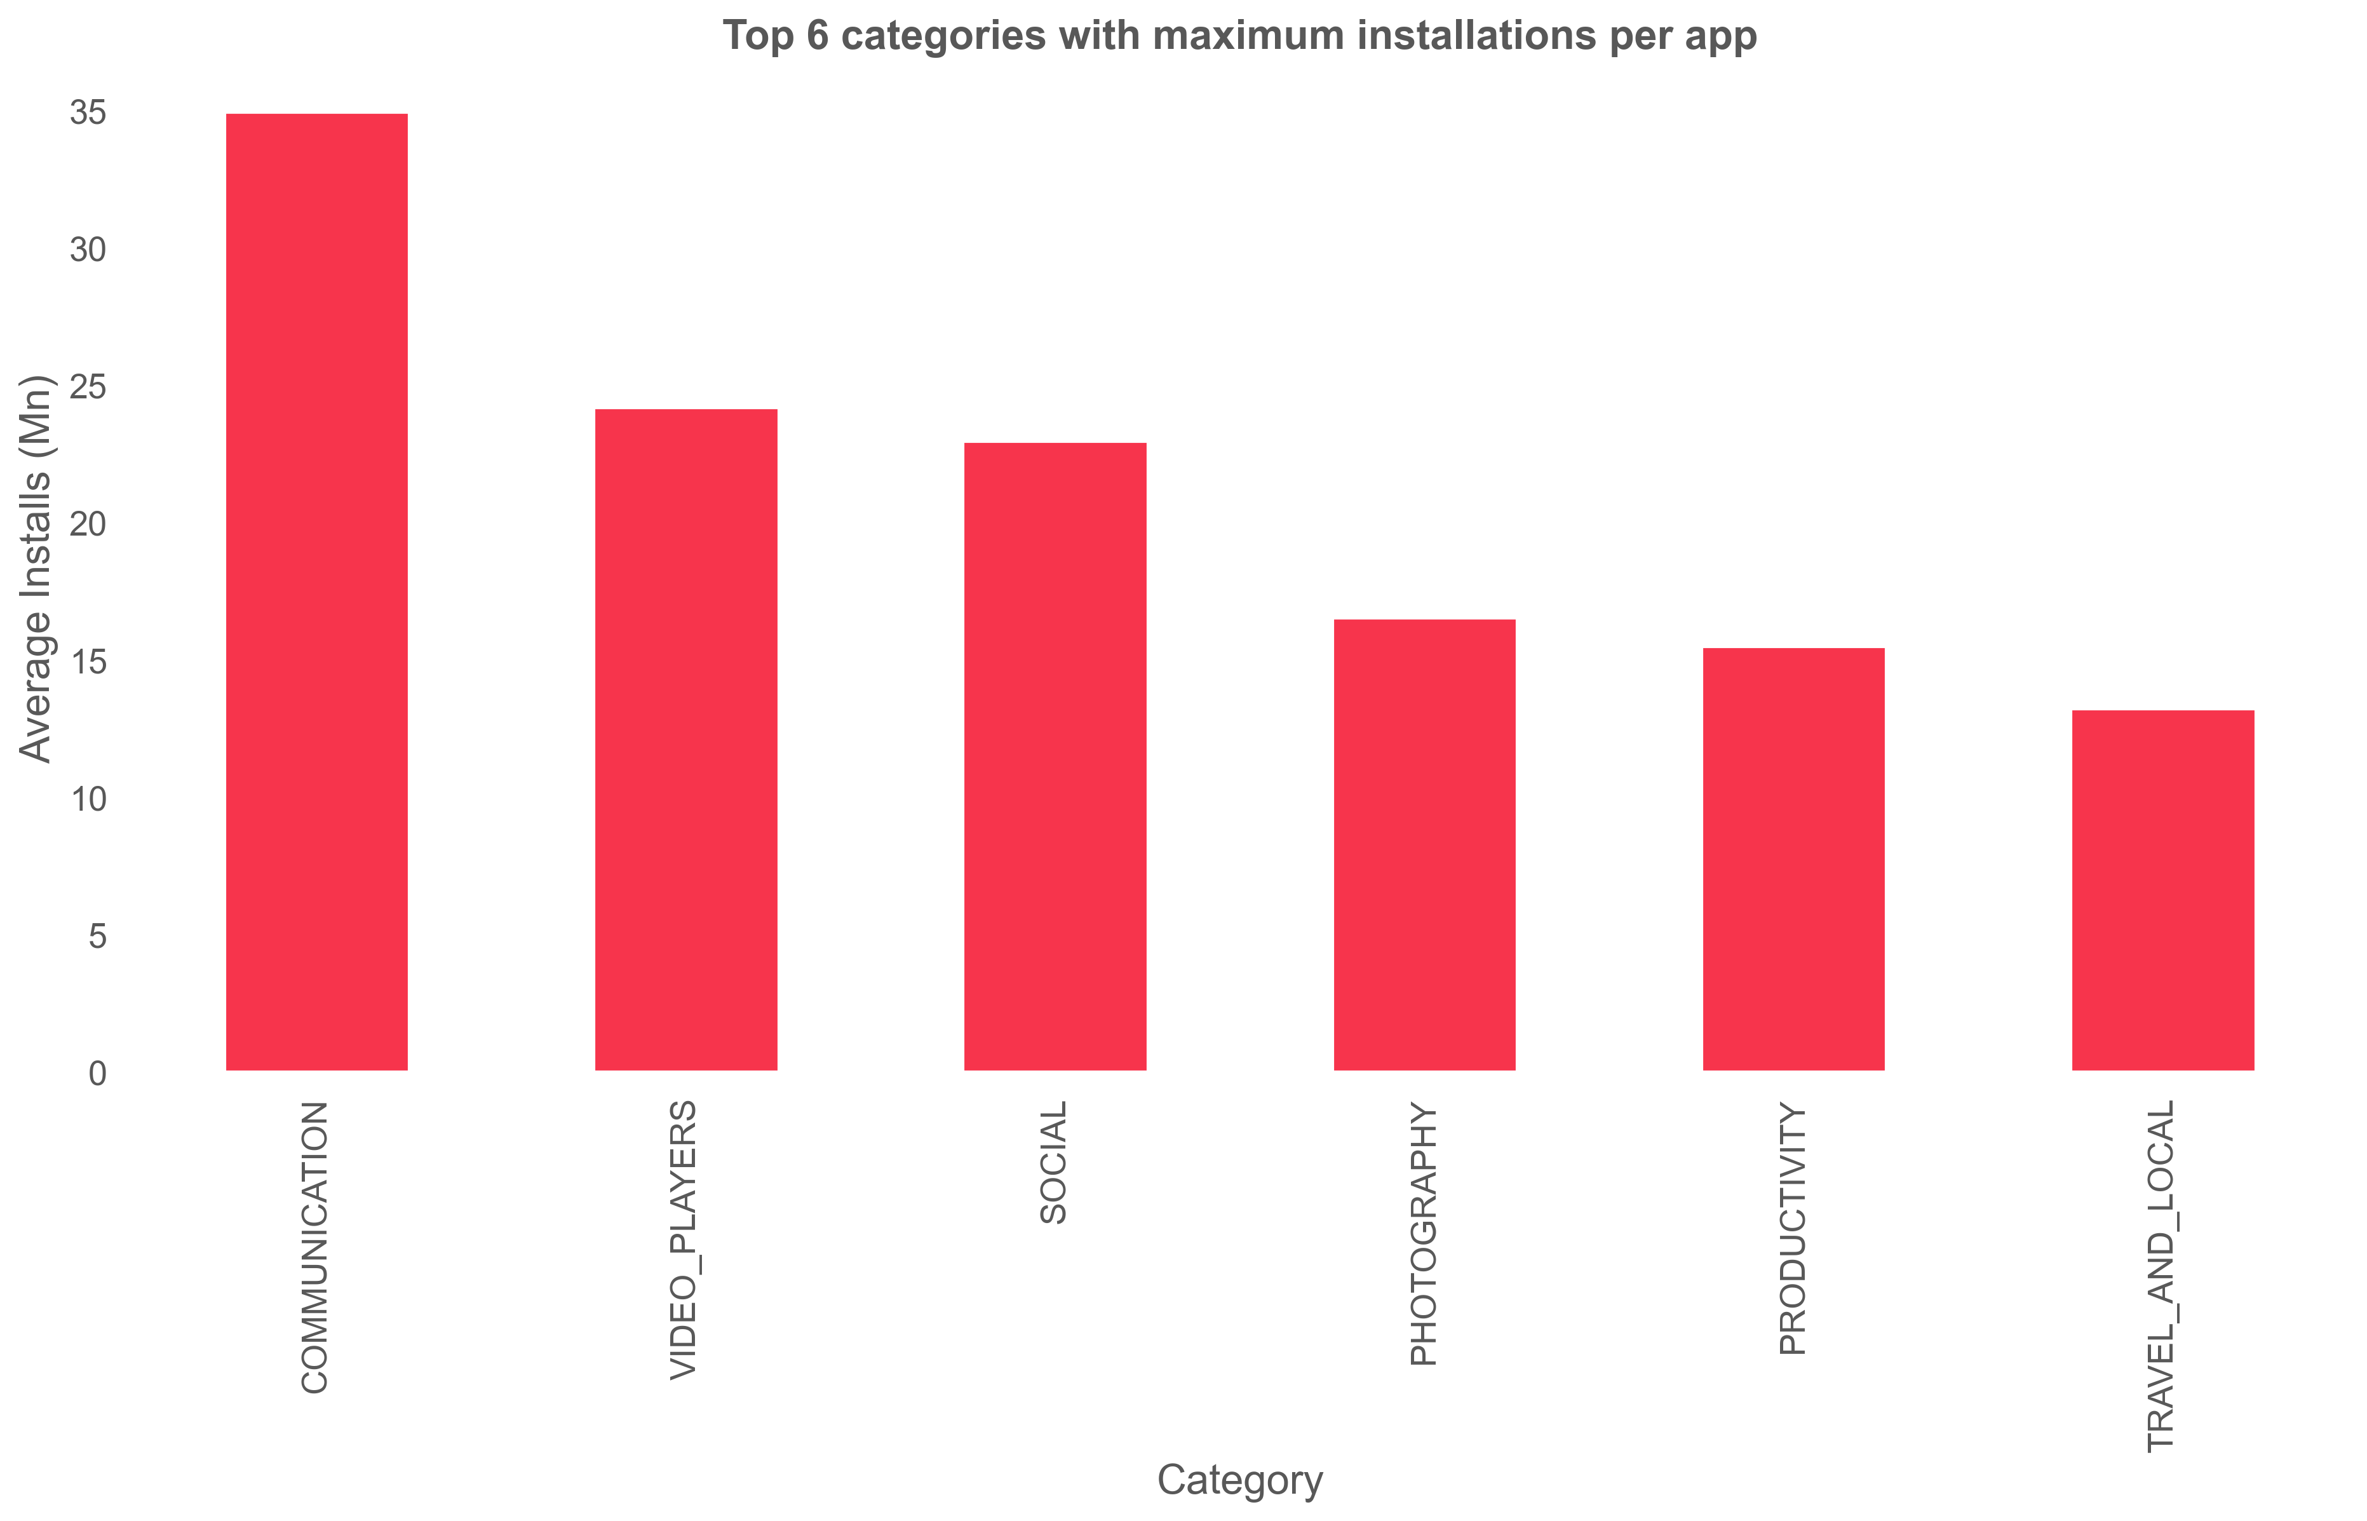
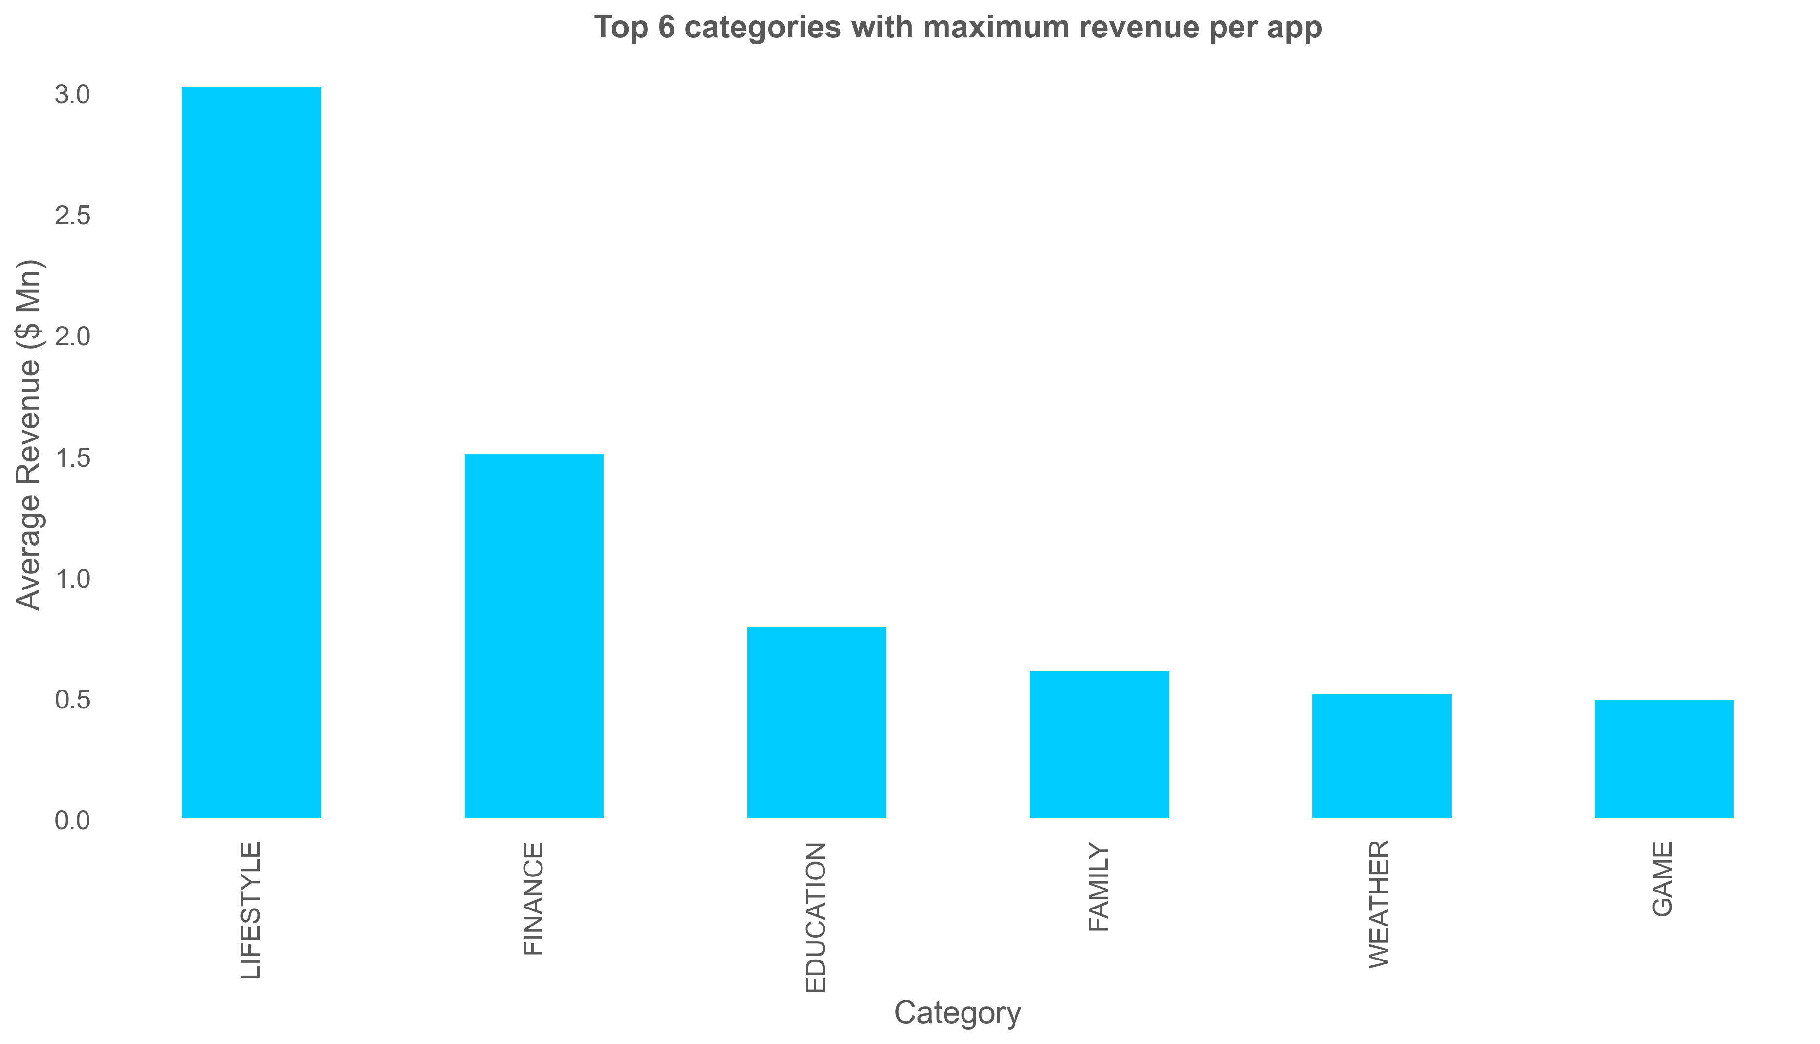
Top categories with maximum installations per app
Top categories with maximum revenue per app

Slide 11
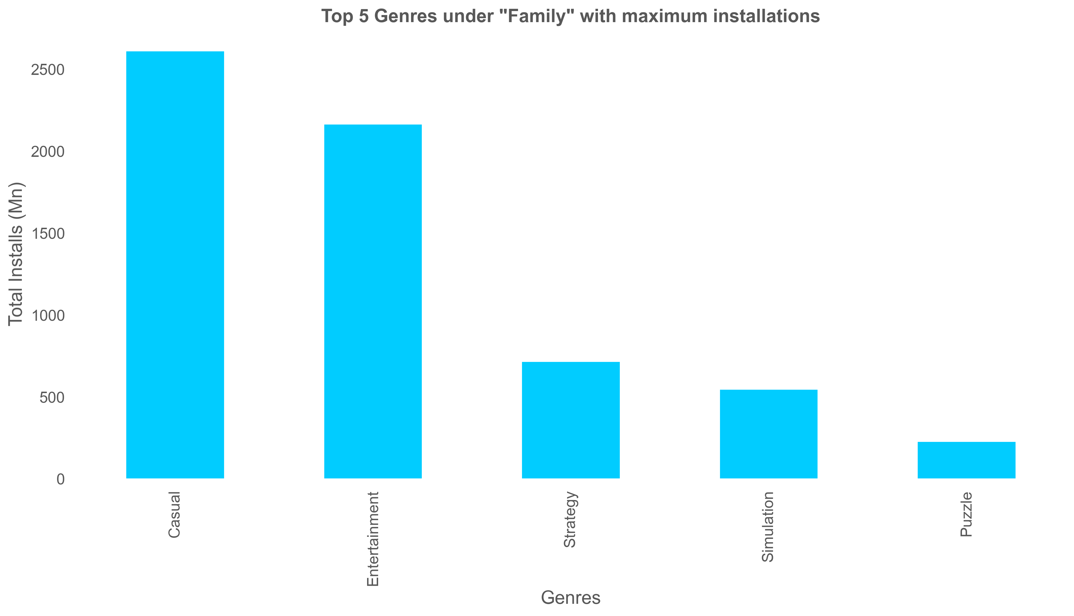
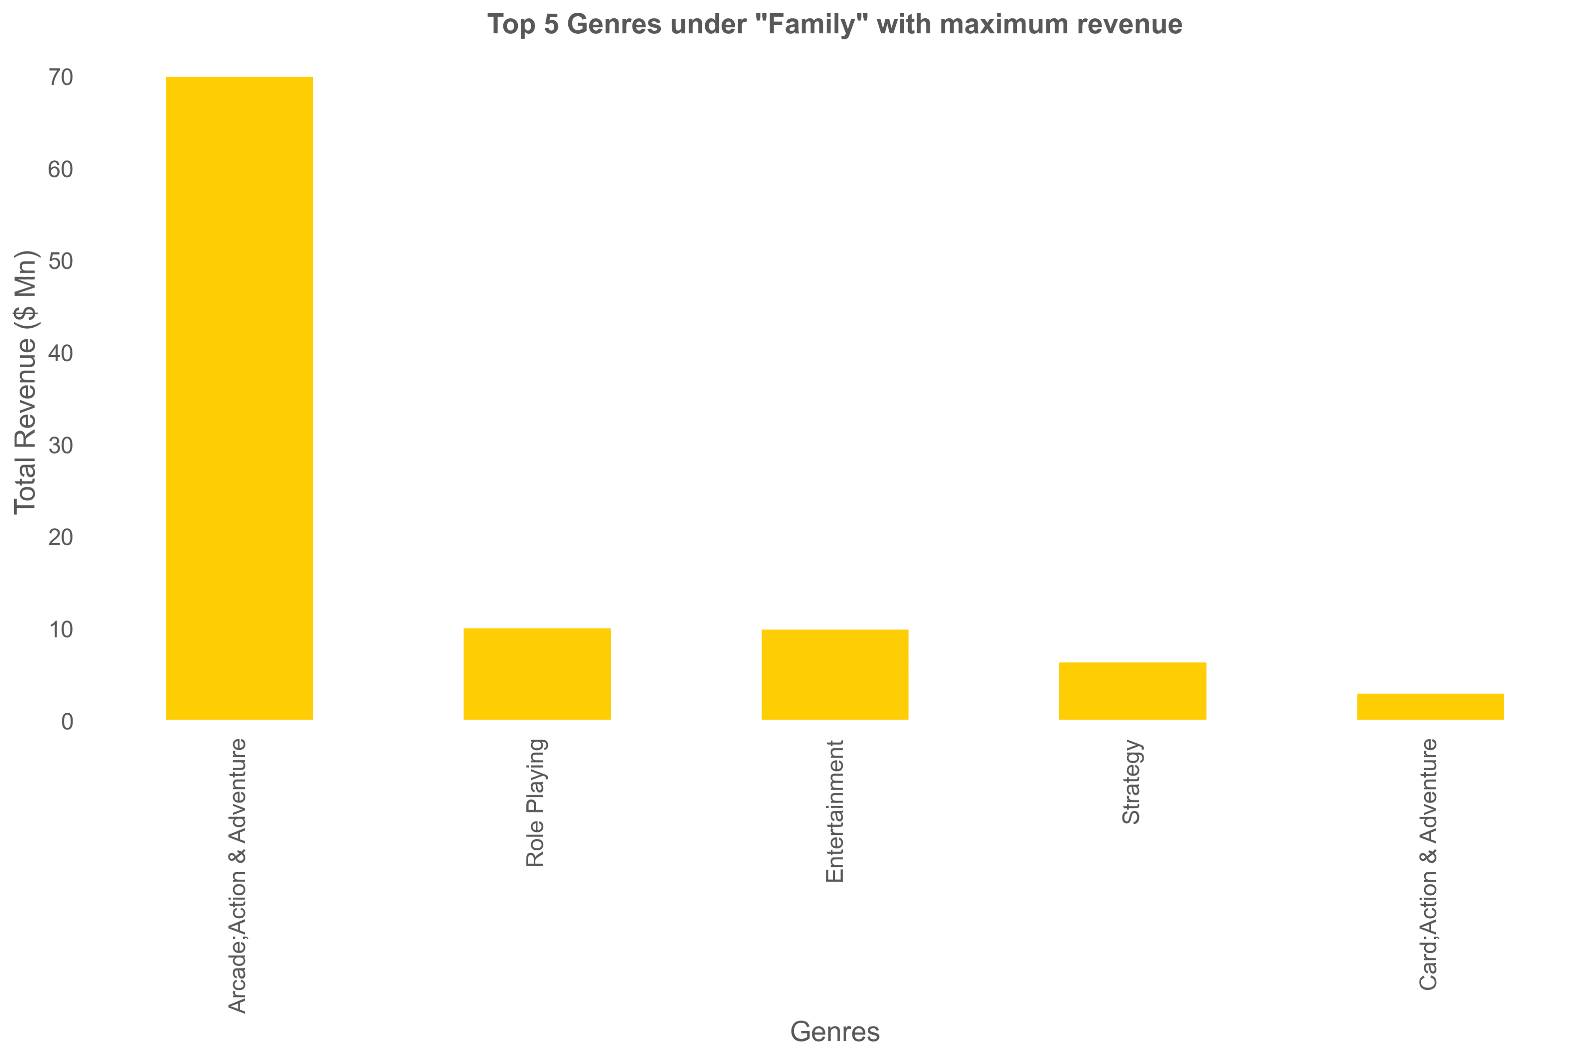
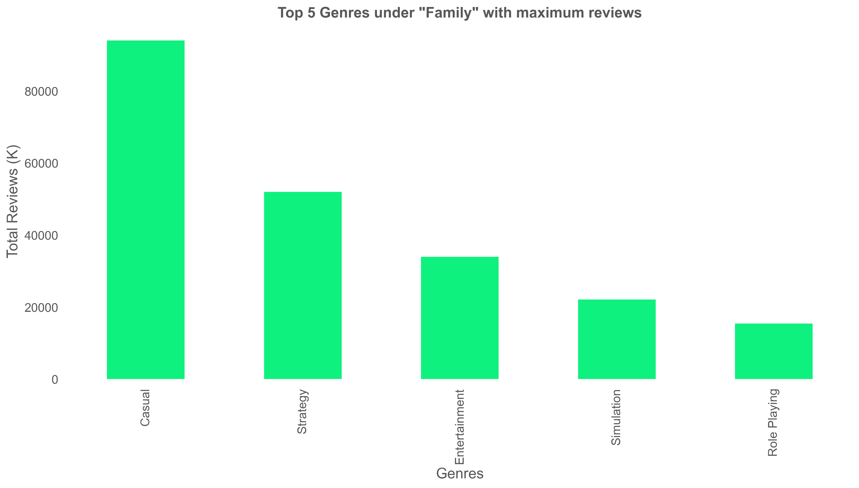

Slide 12
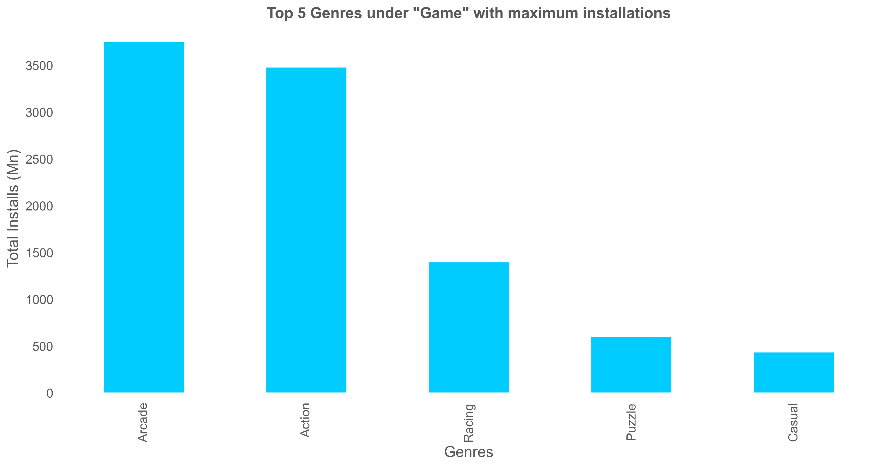
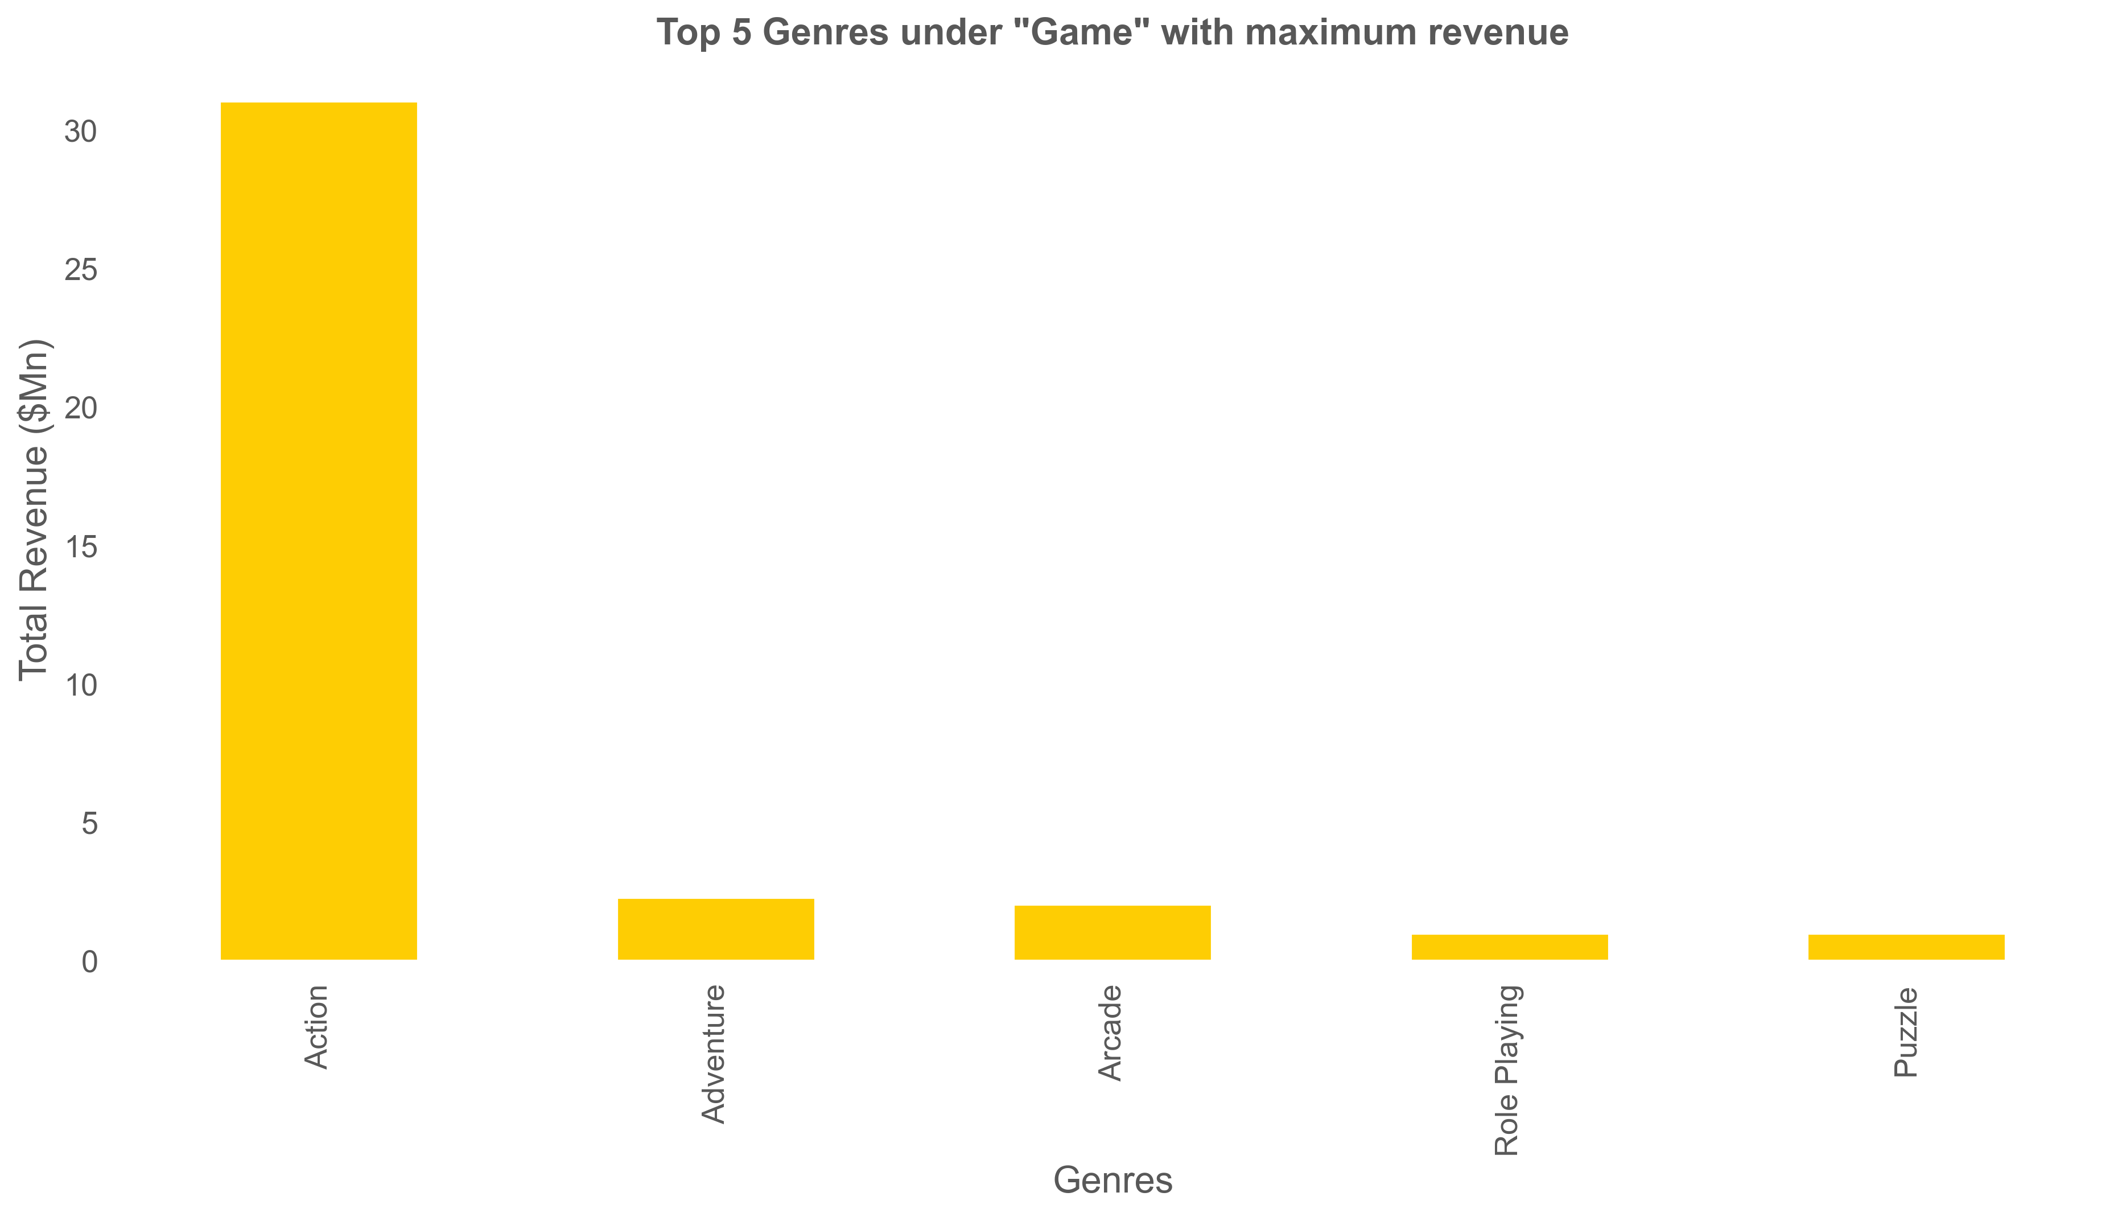
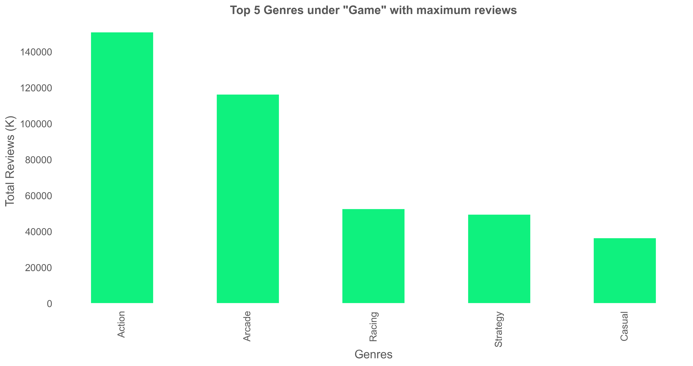

Slide 13
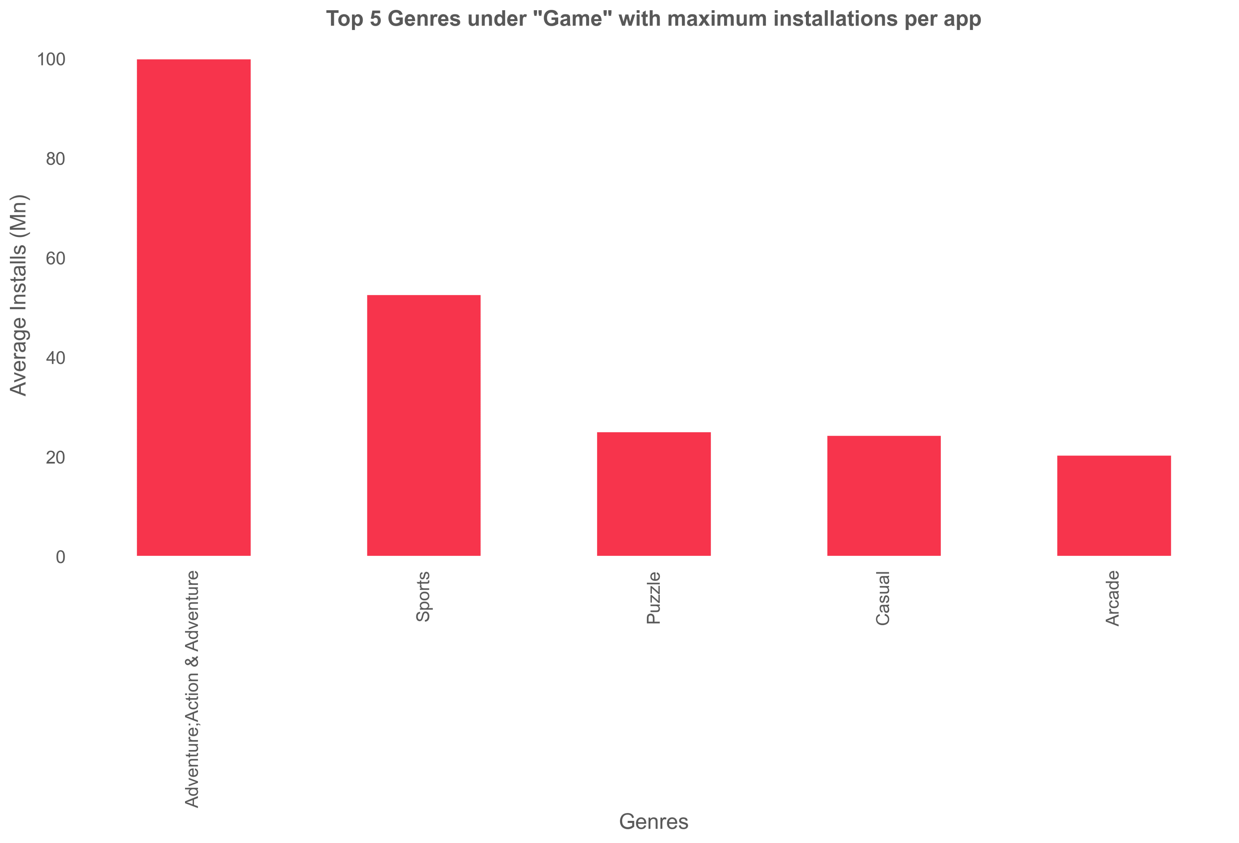
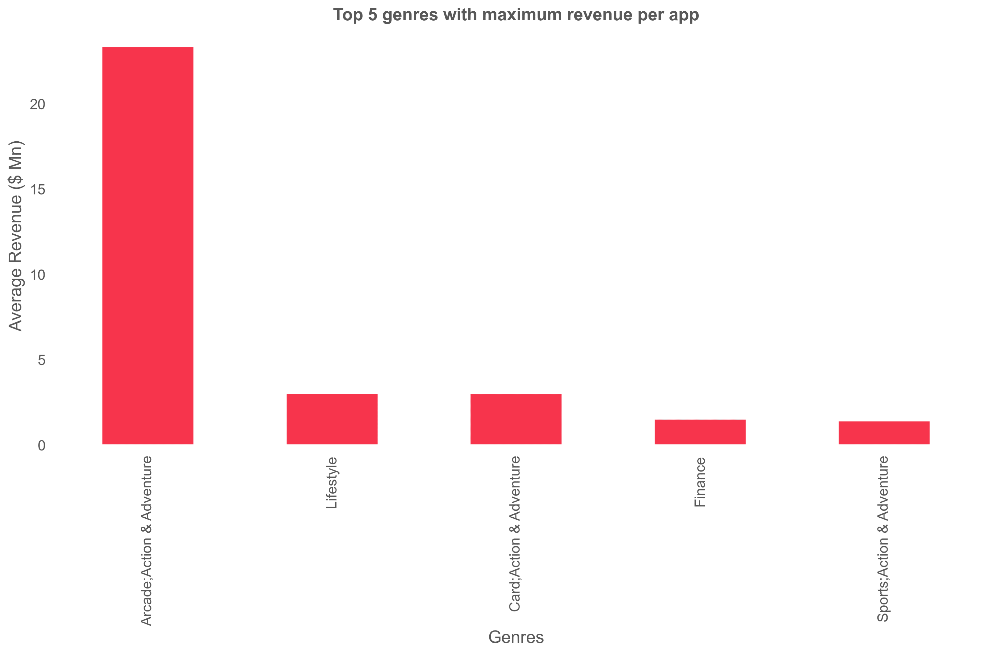
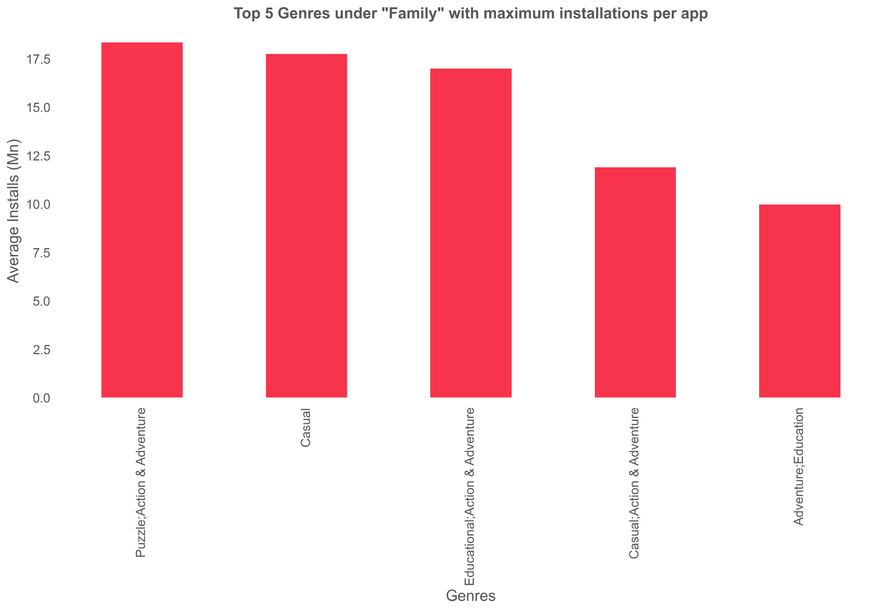

Slide 14
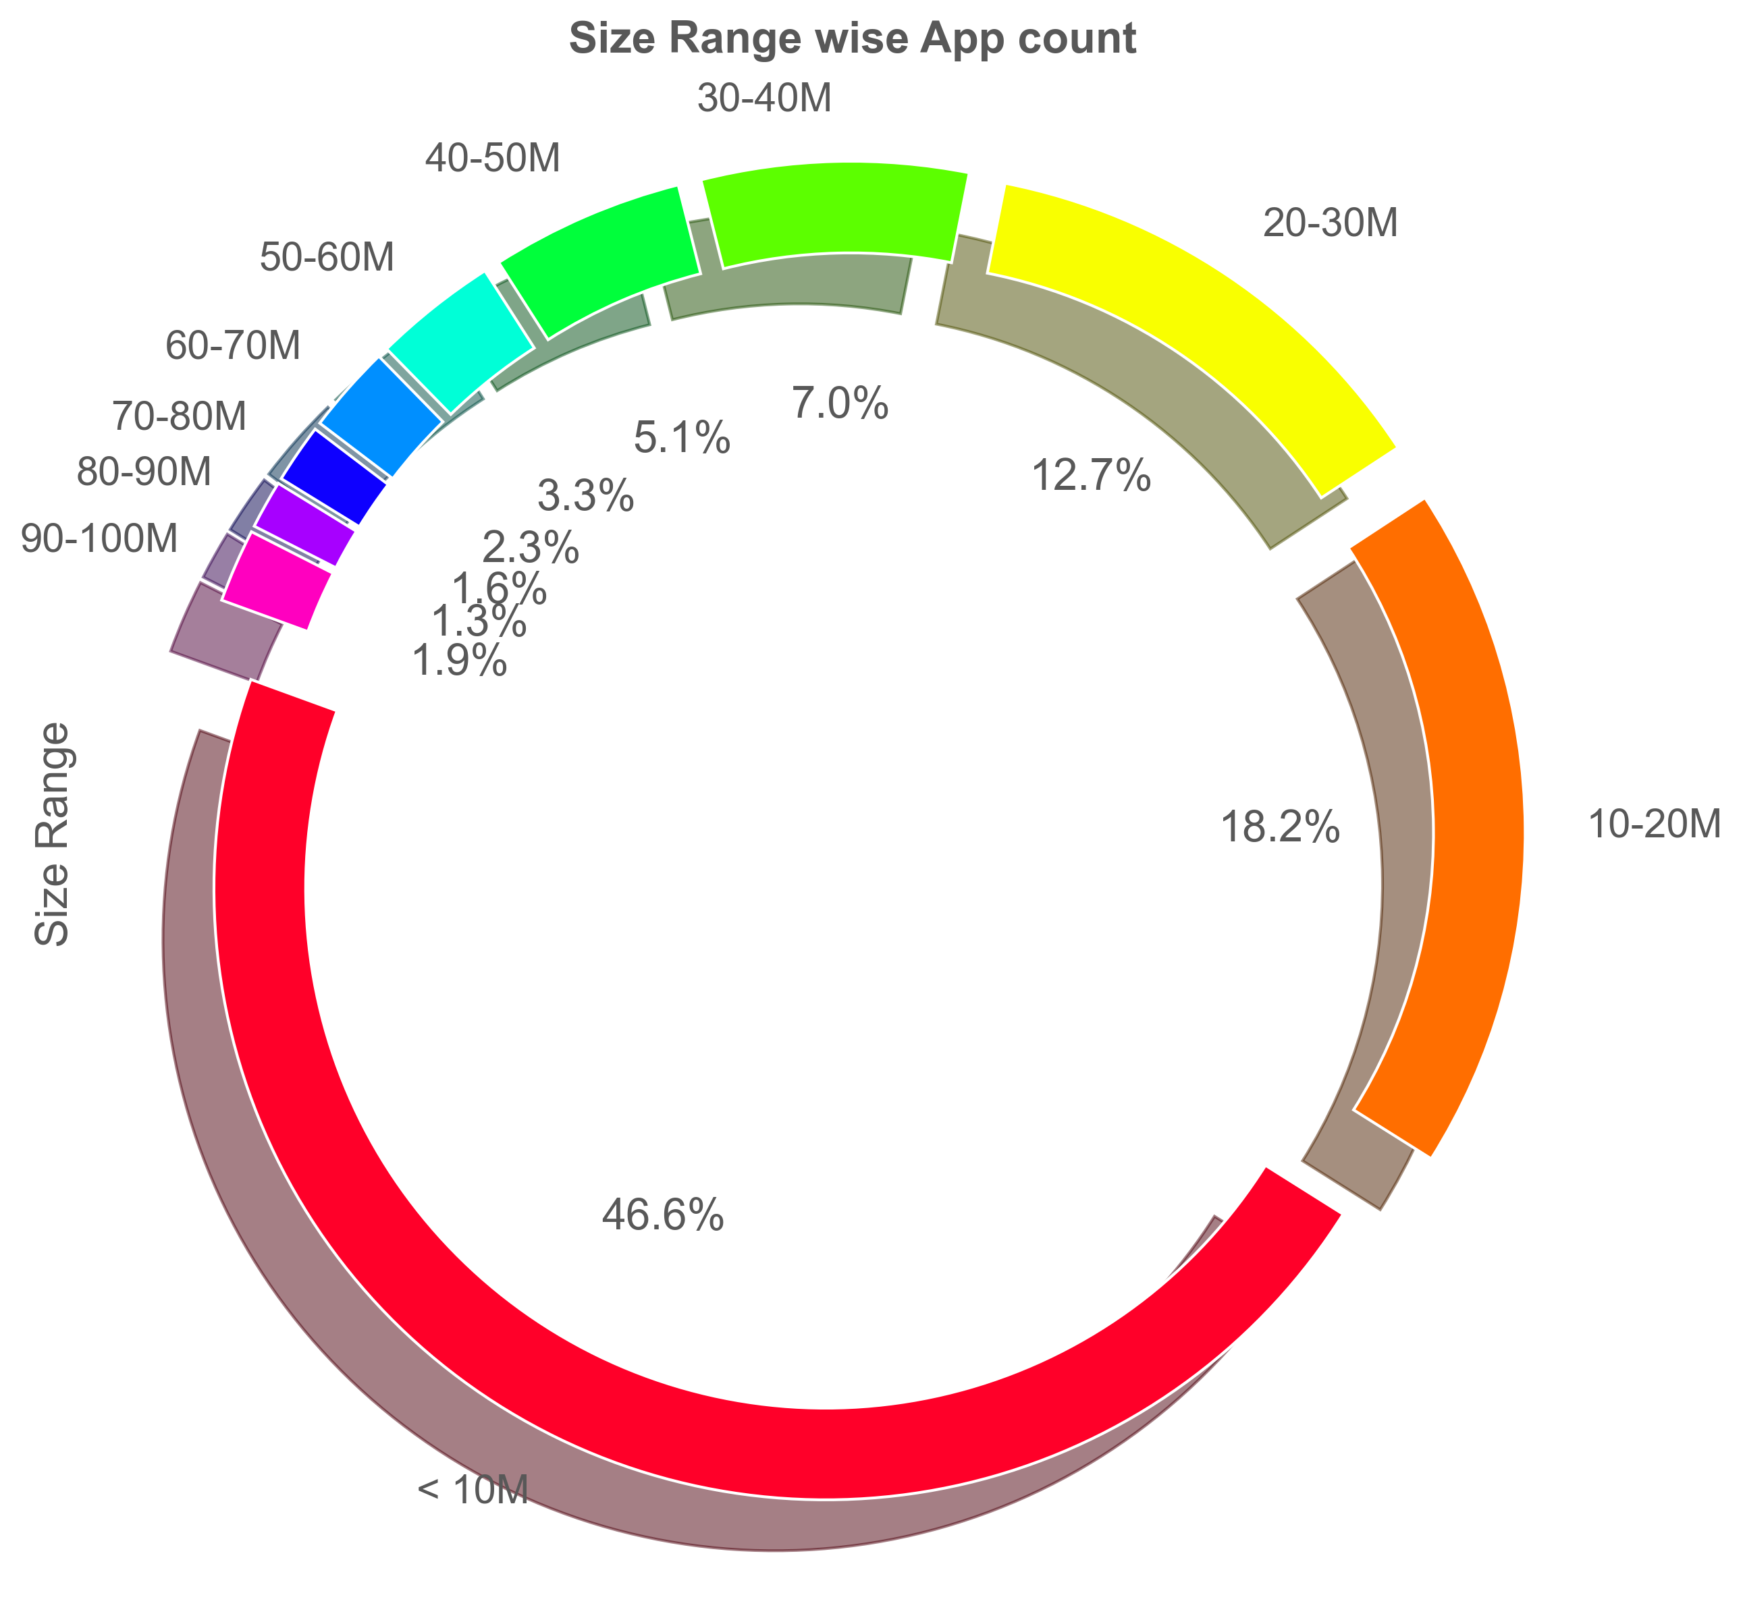
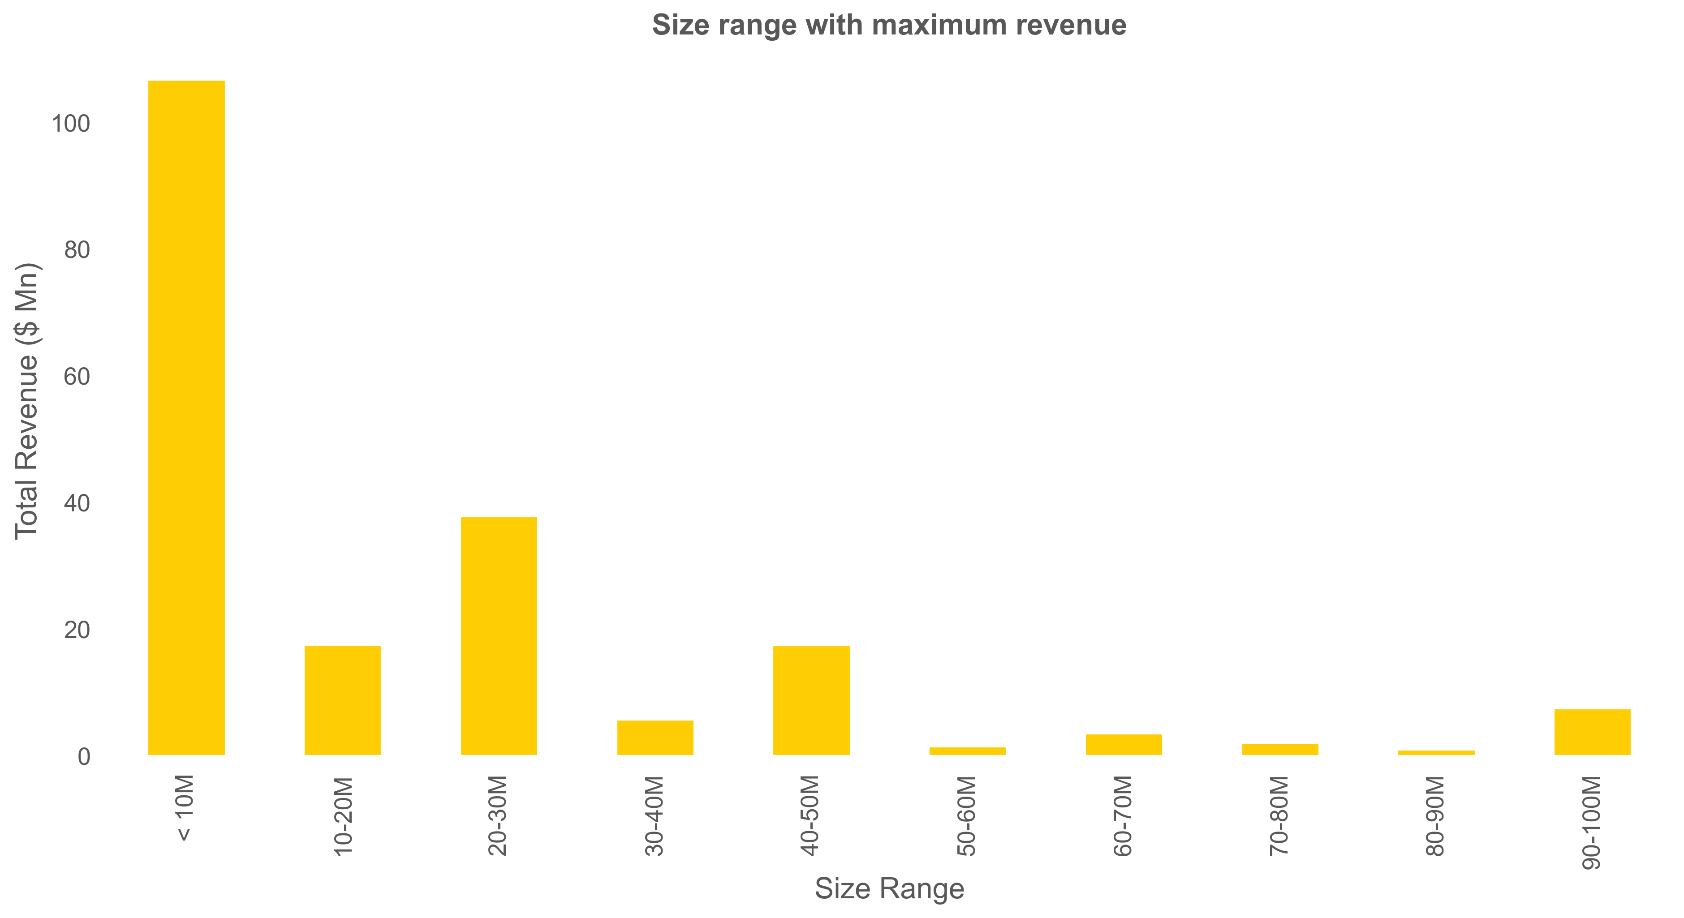
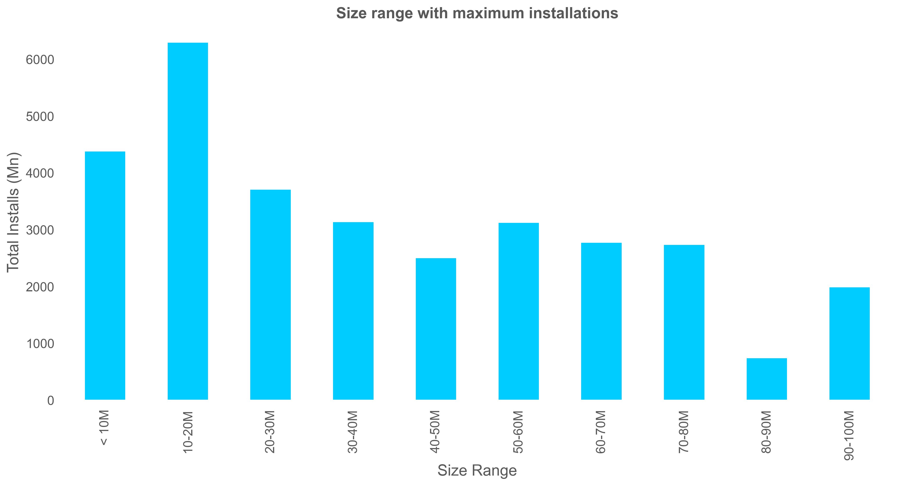
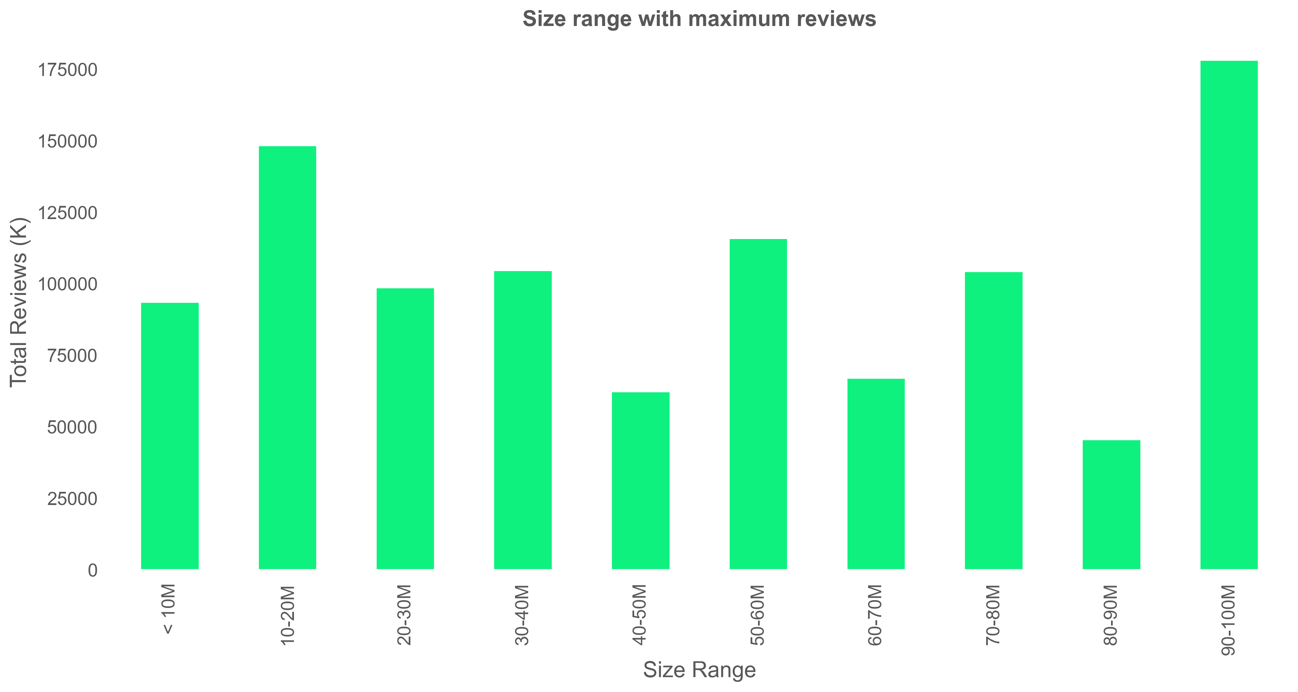

Slide 15
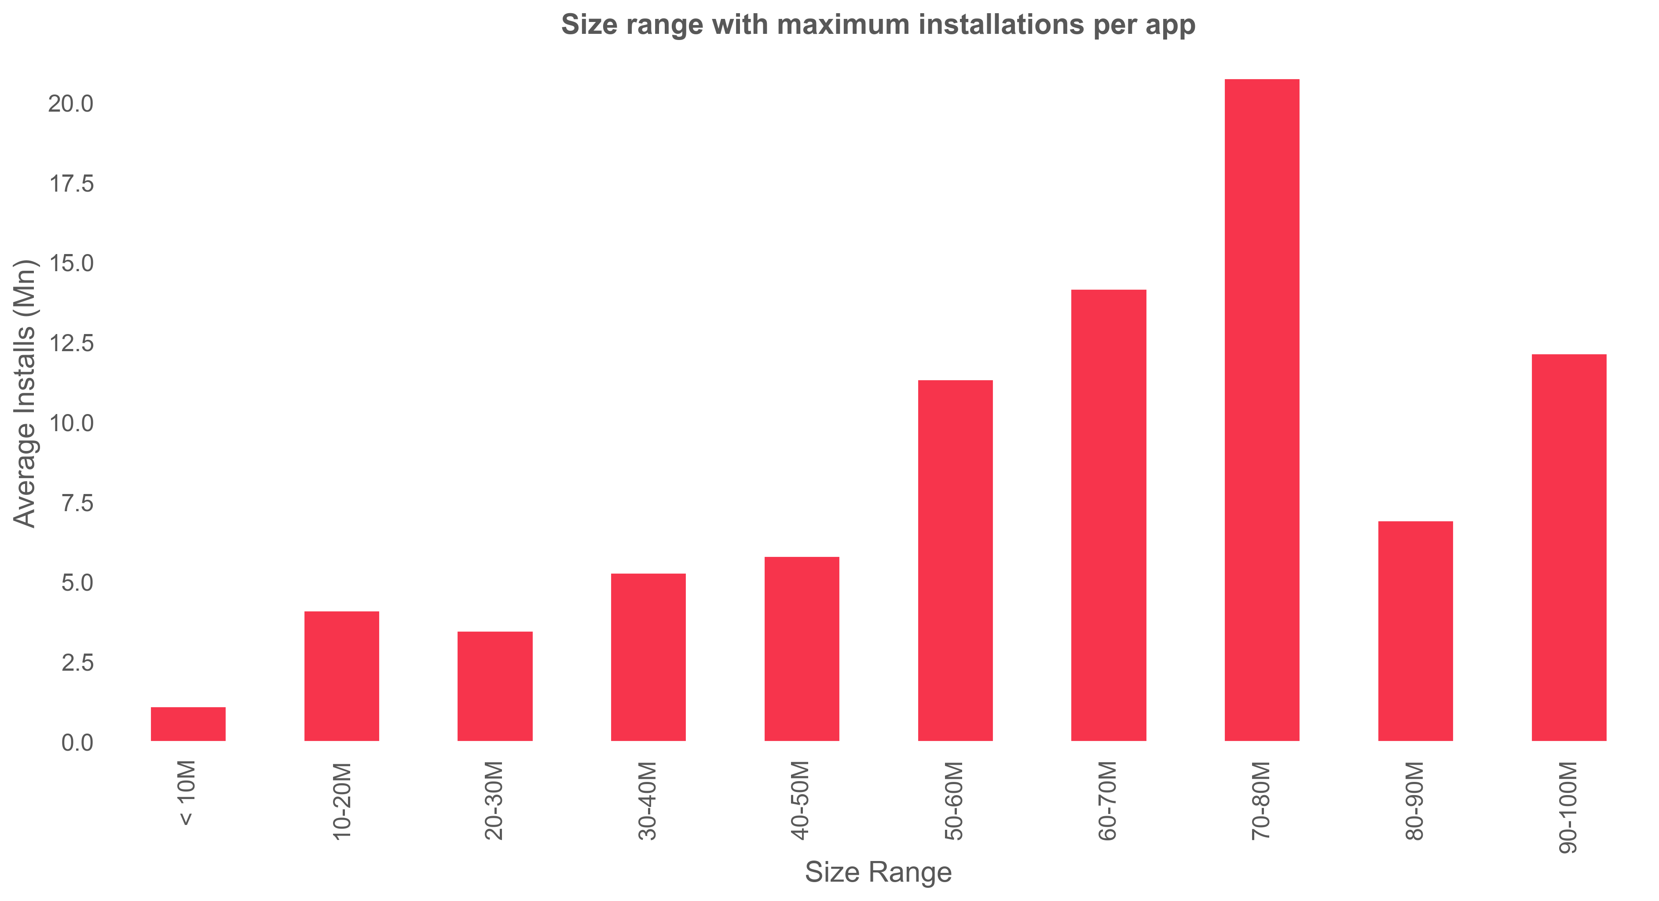
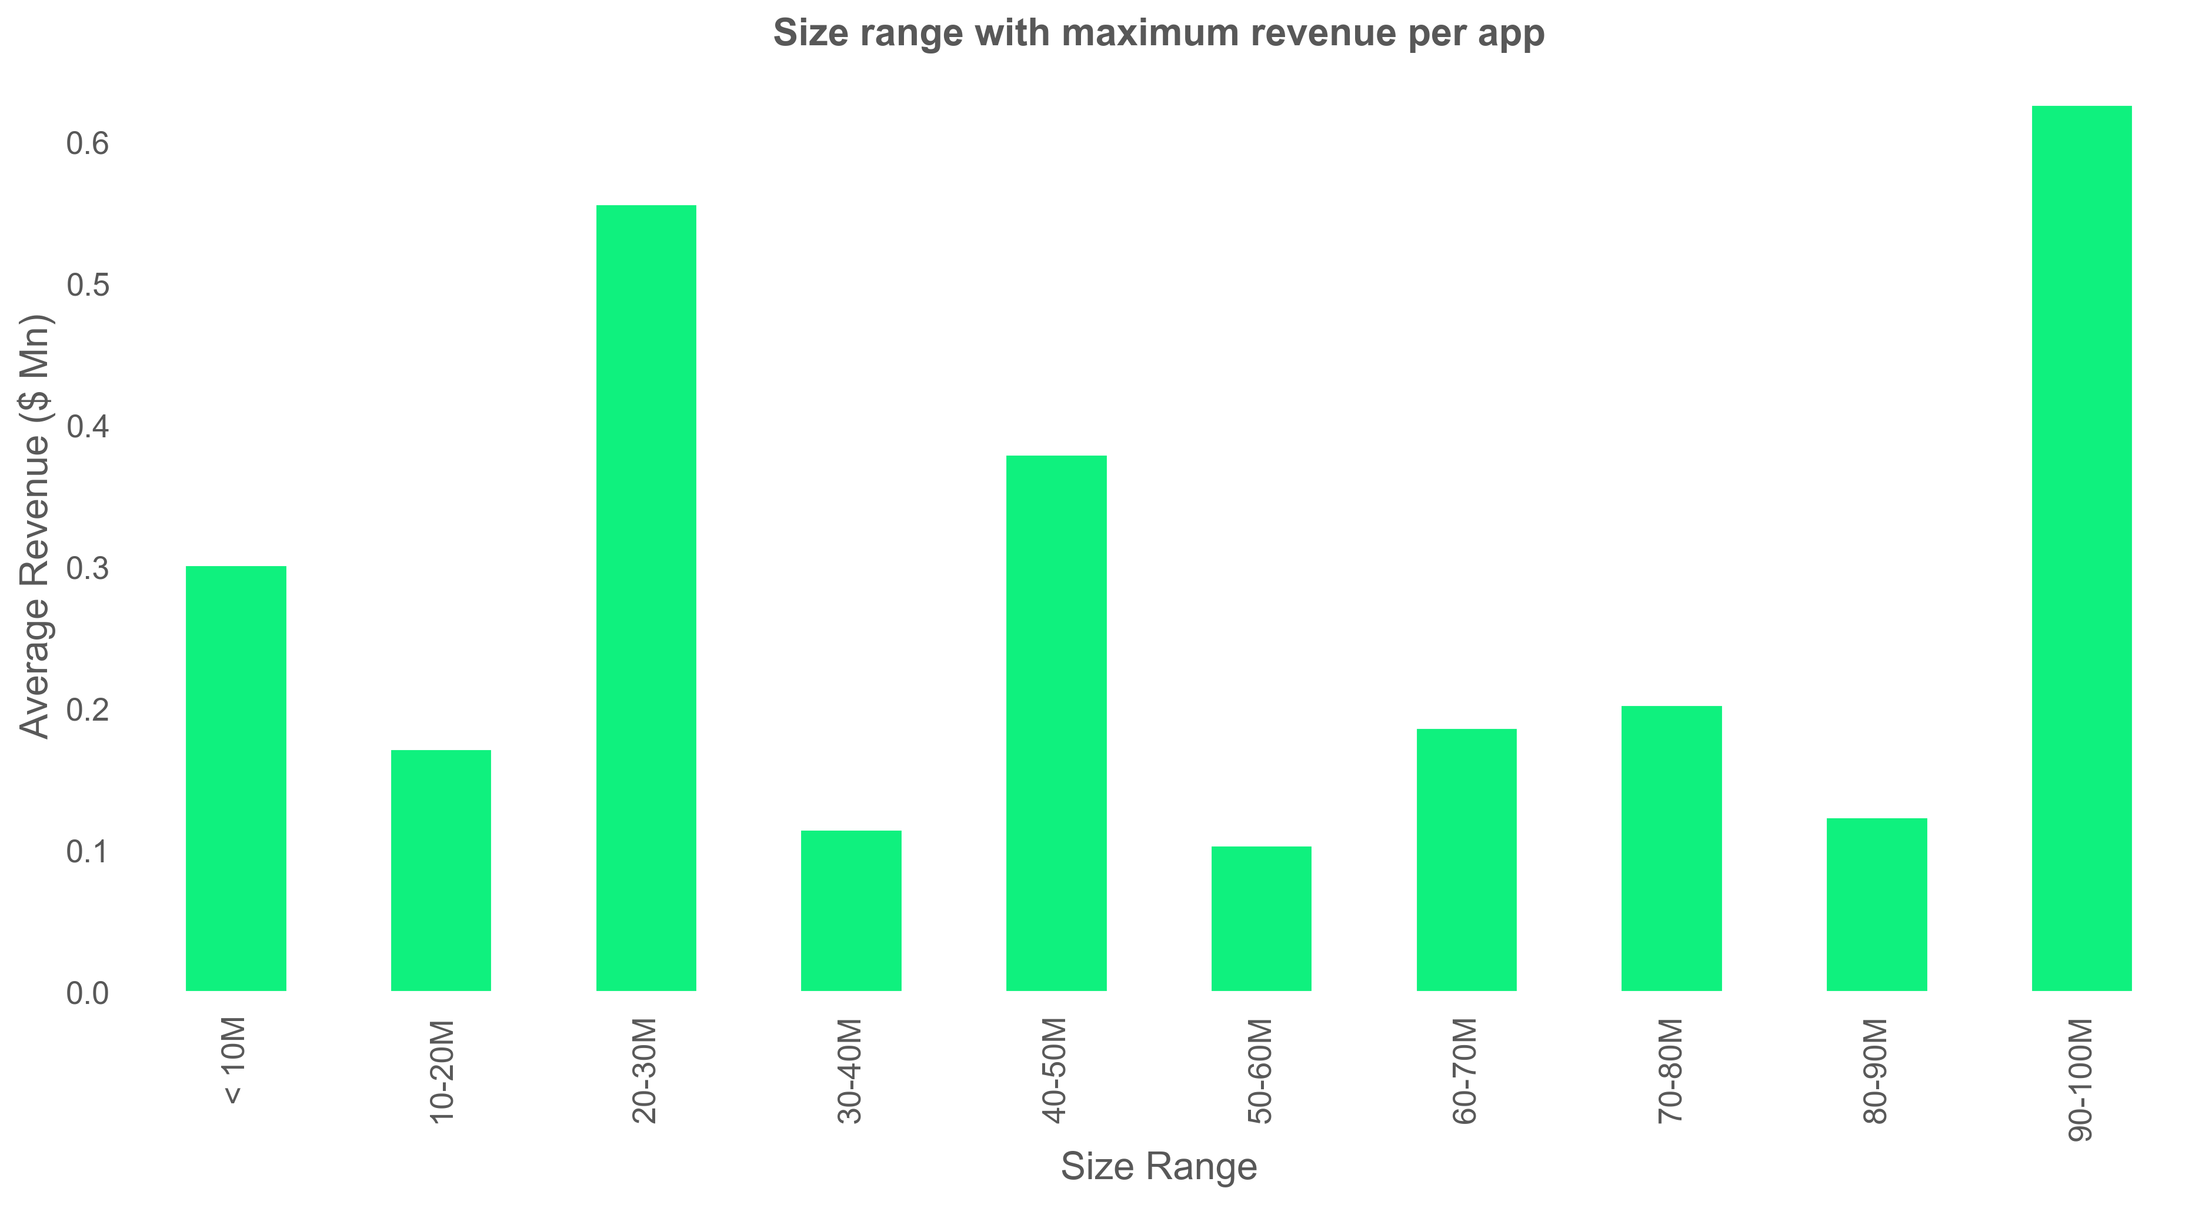
Size range with maximum installations per app
Size range with maximum revenue per app

Slide 16
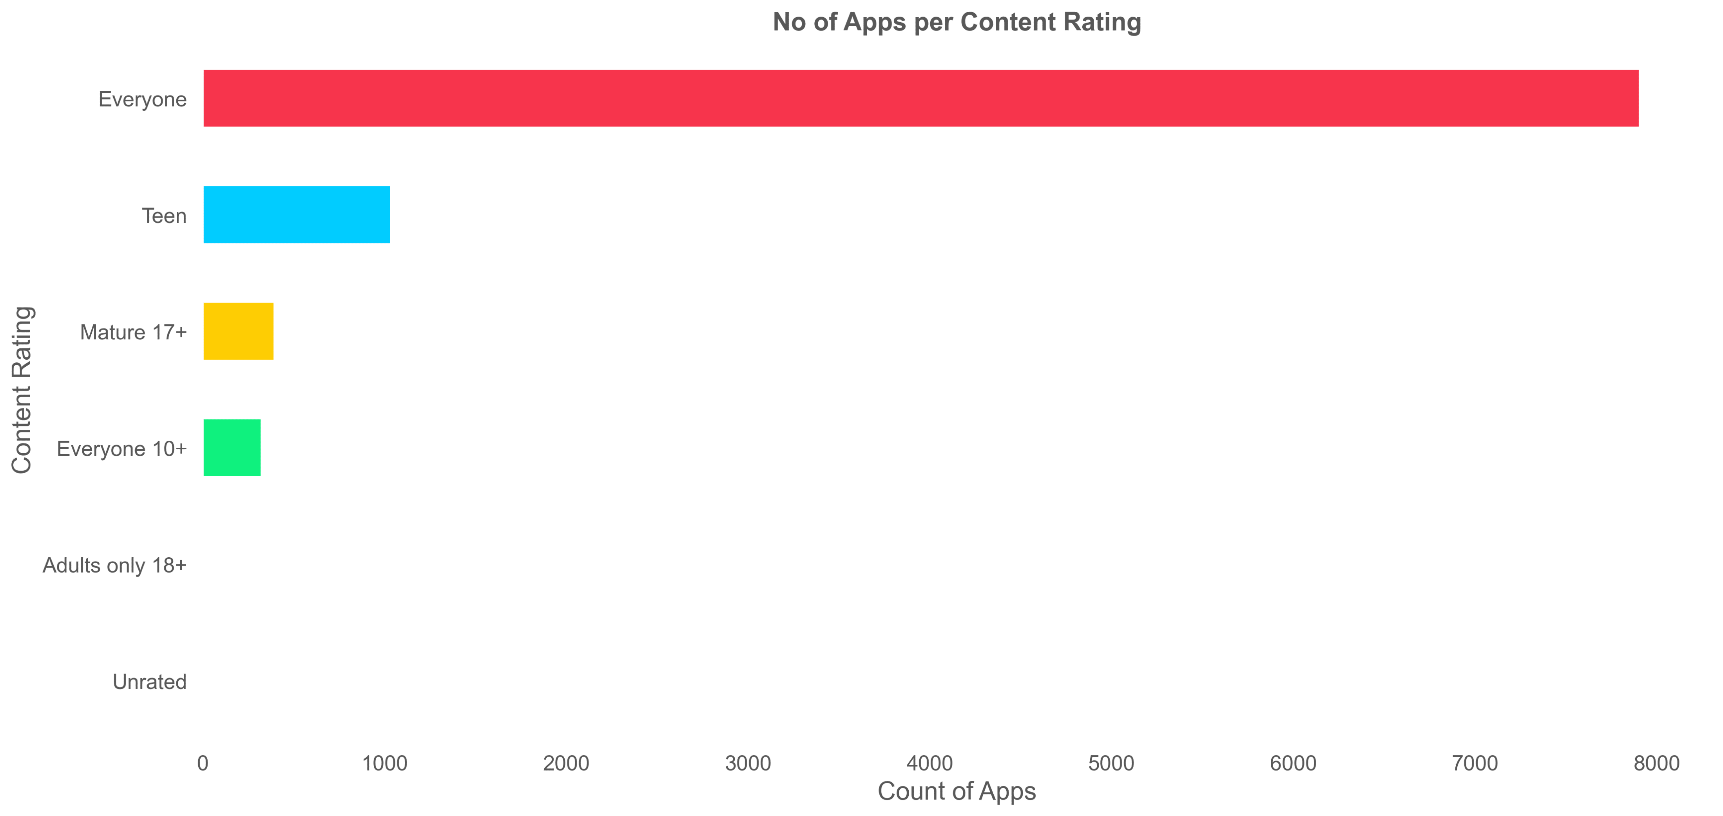
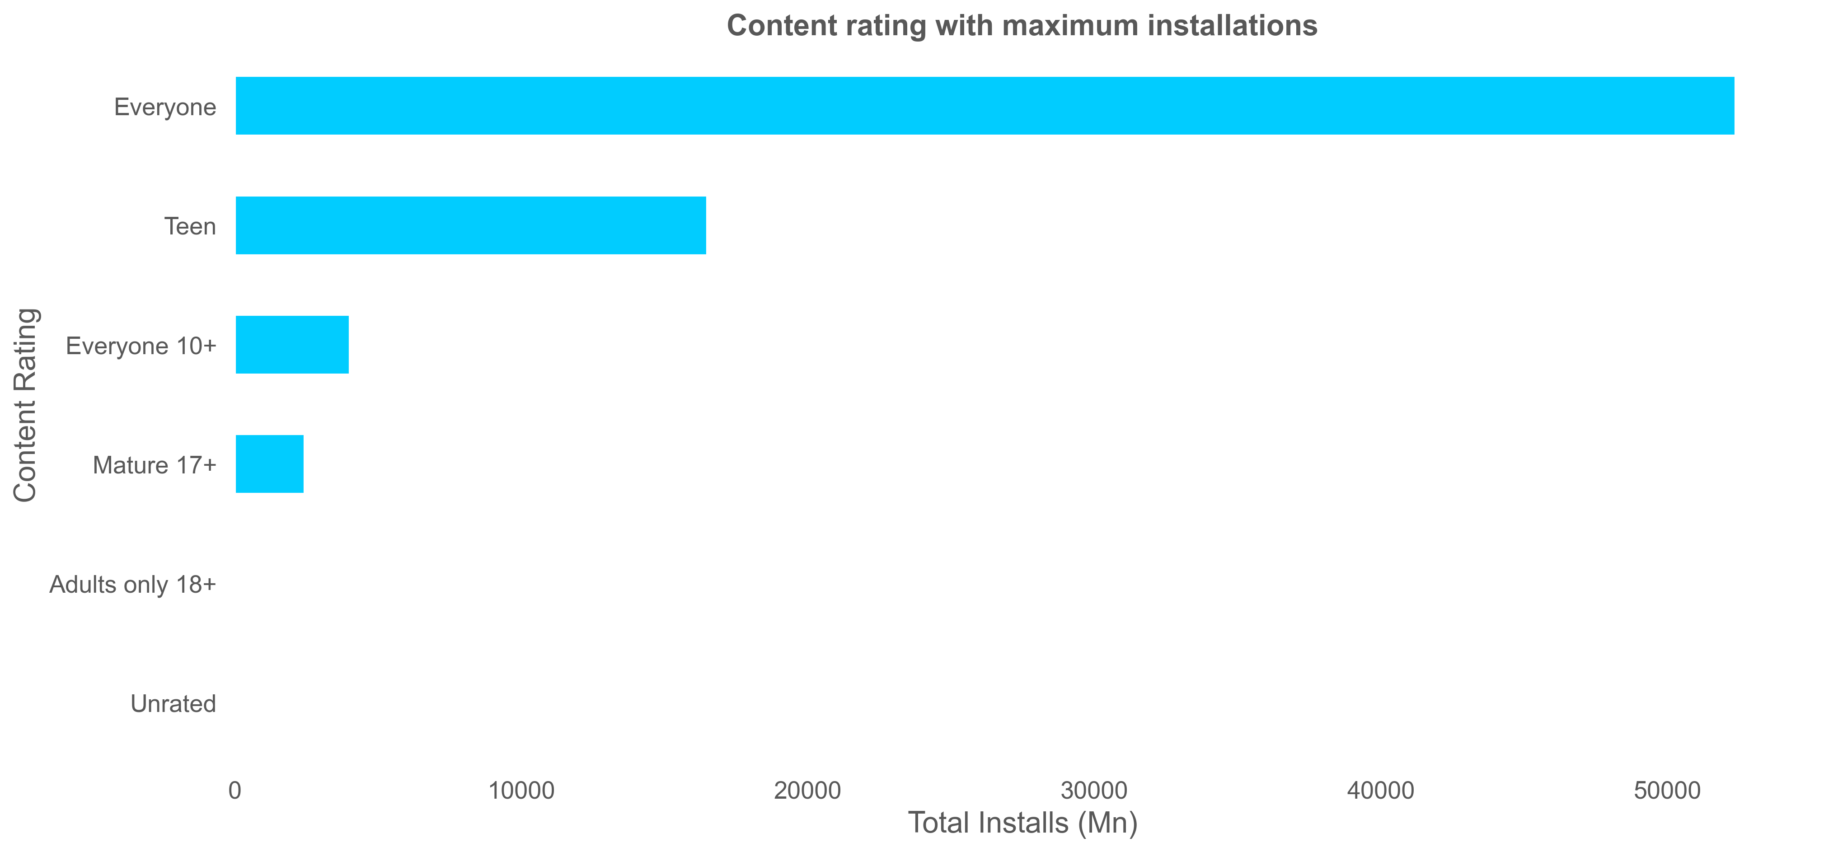
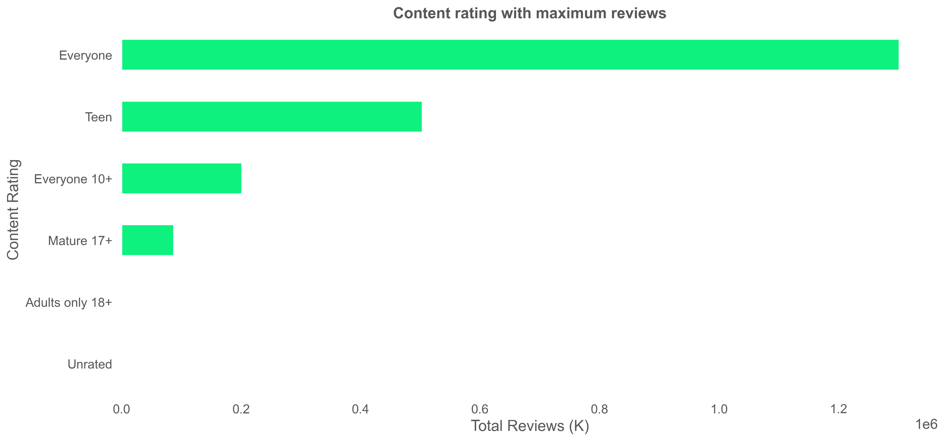
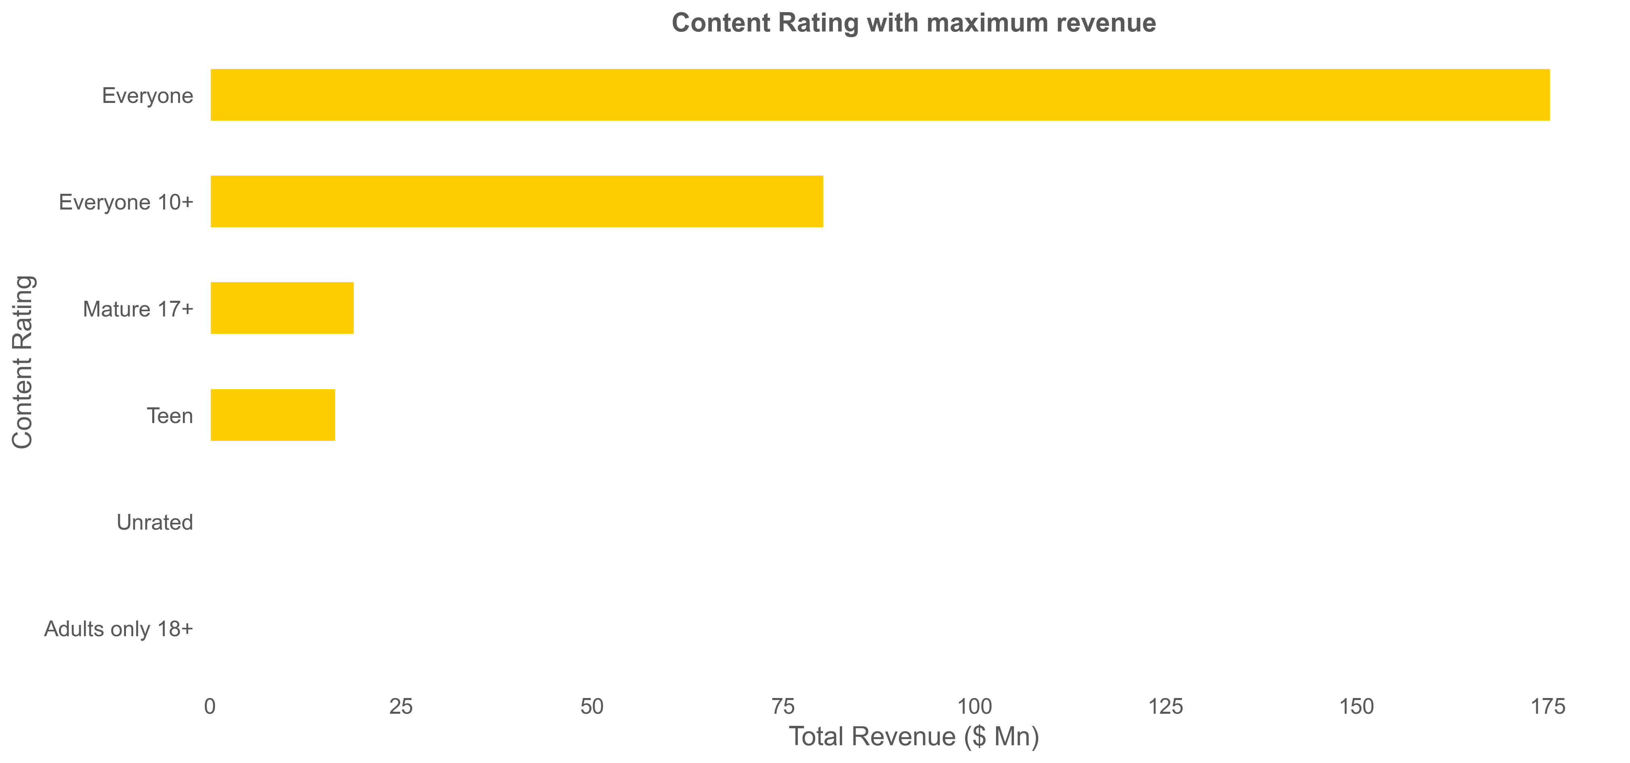

Slide 17
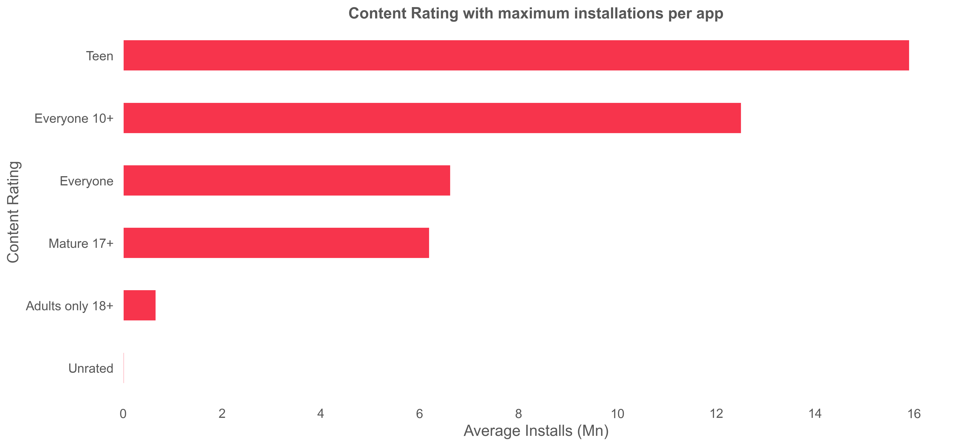
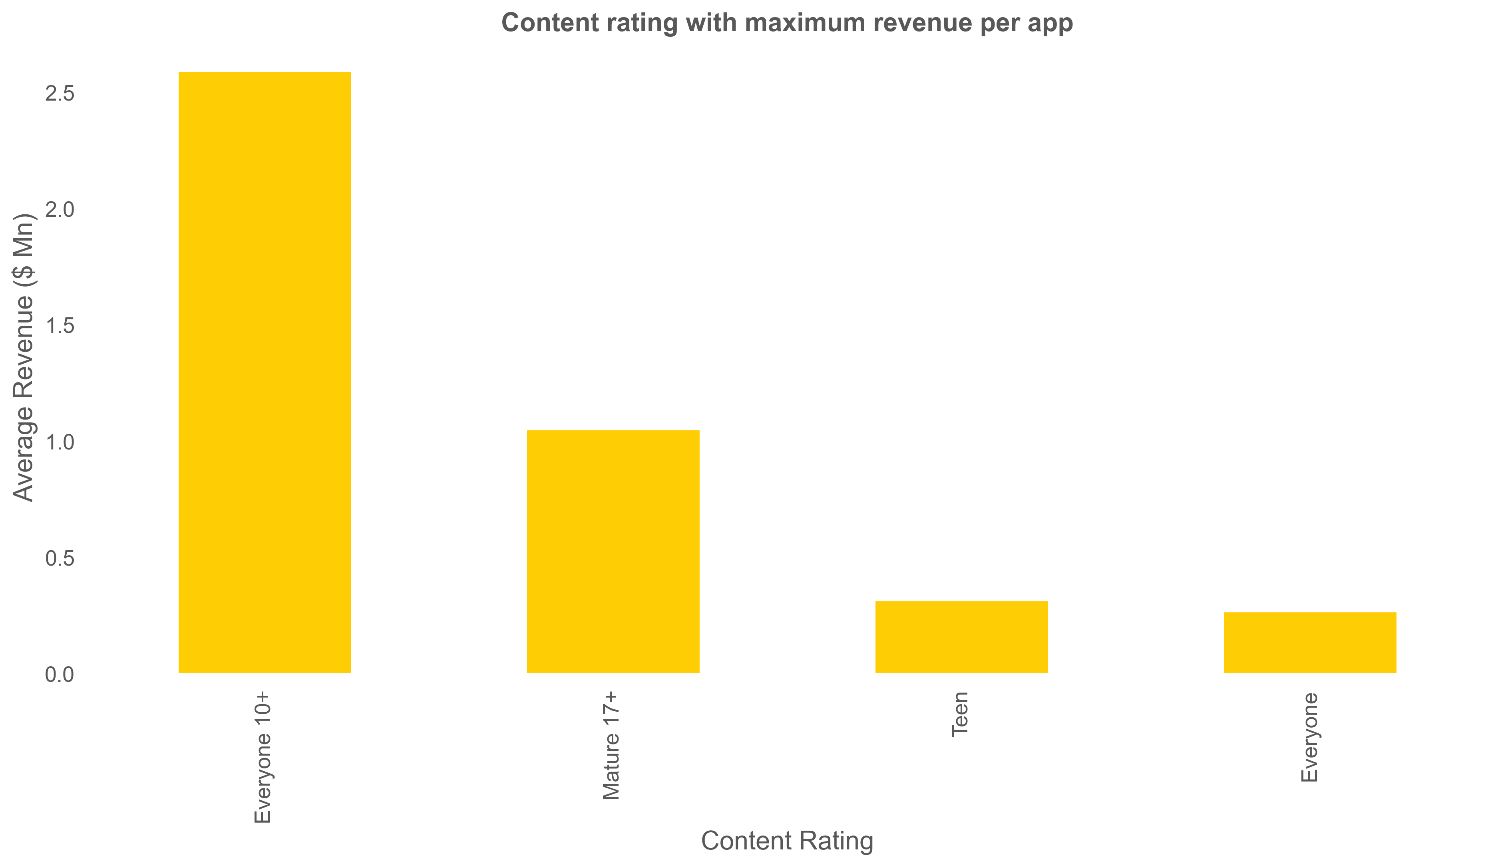
Content rating with maximum installations per app
Content rating with maximum revenue per app

Slide 18
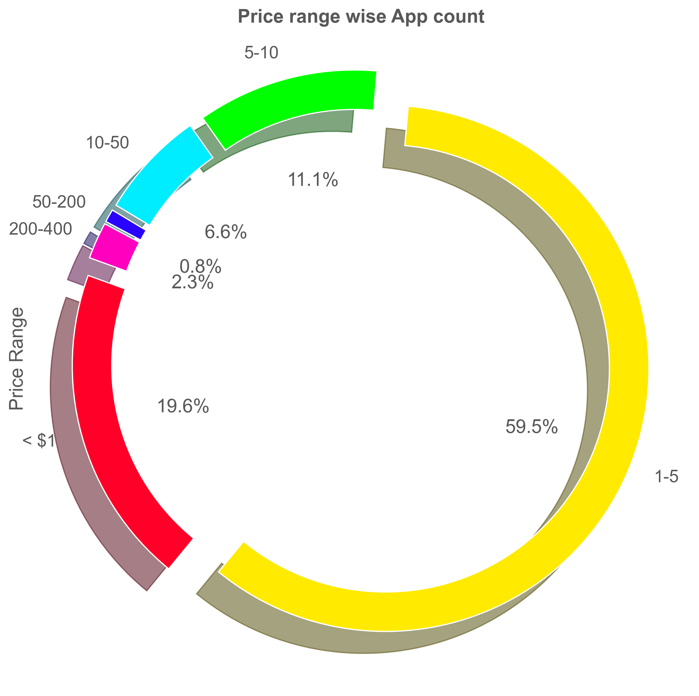
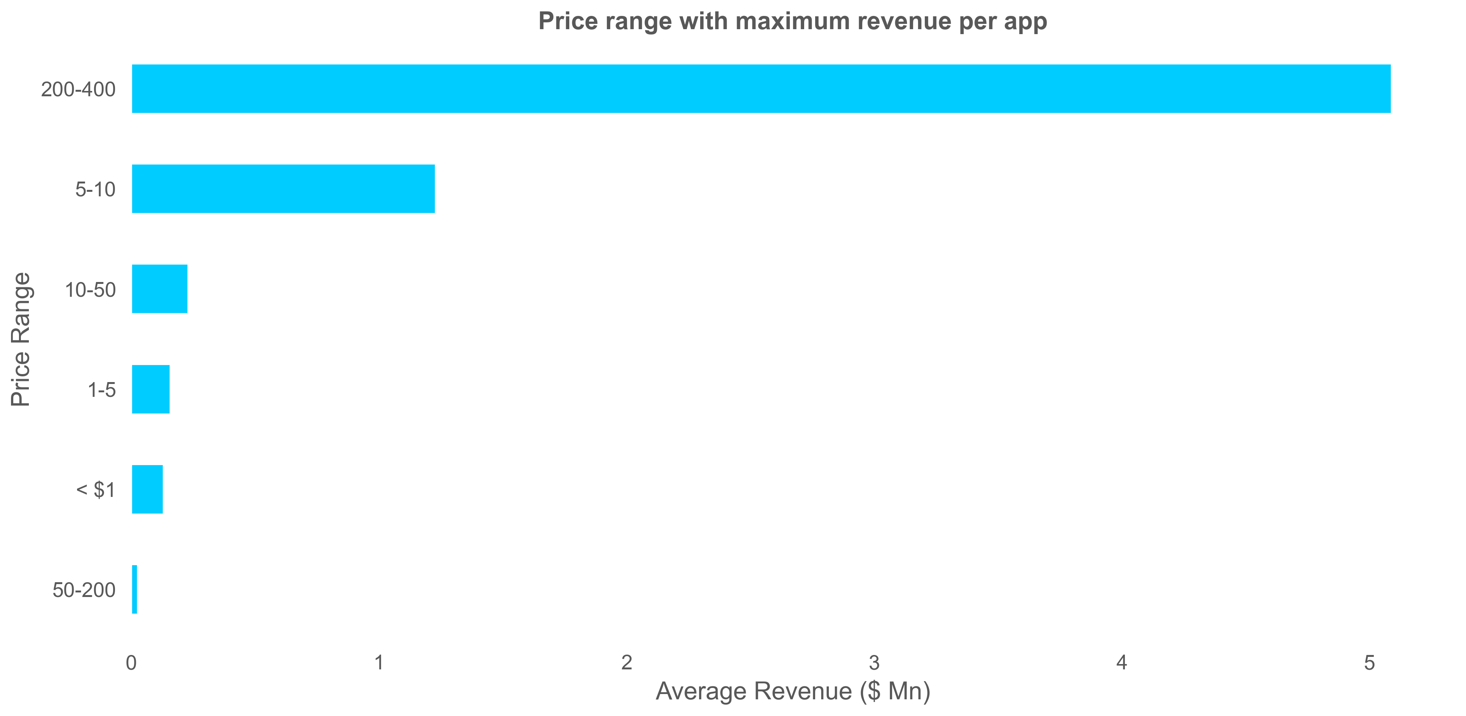
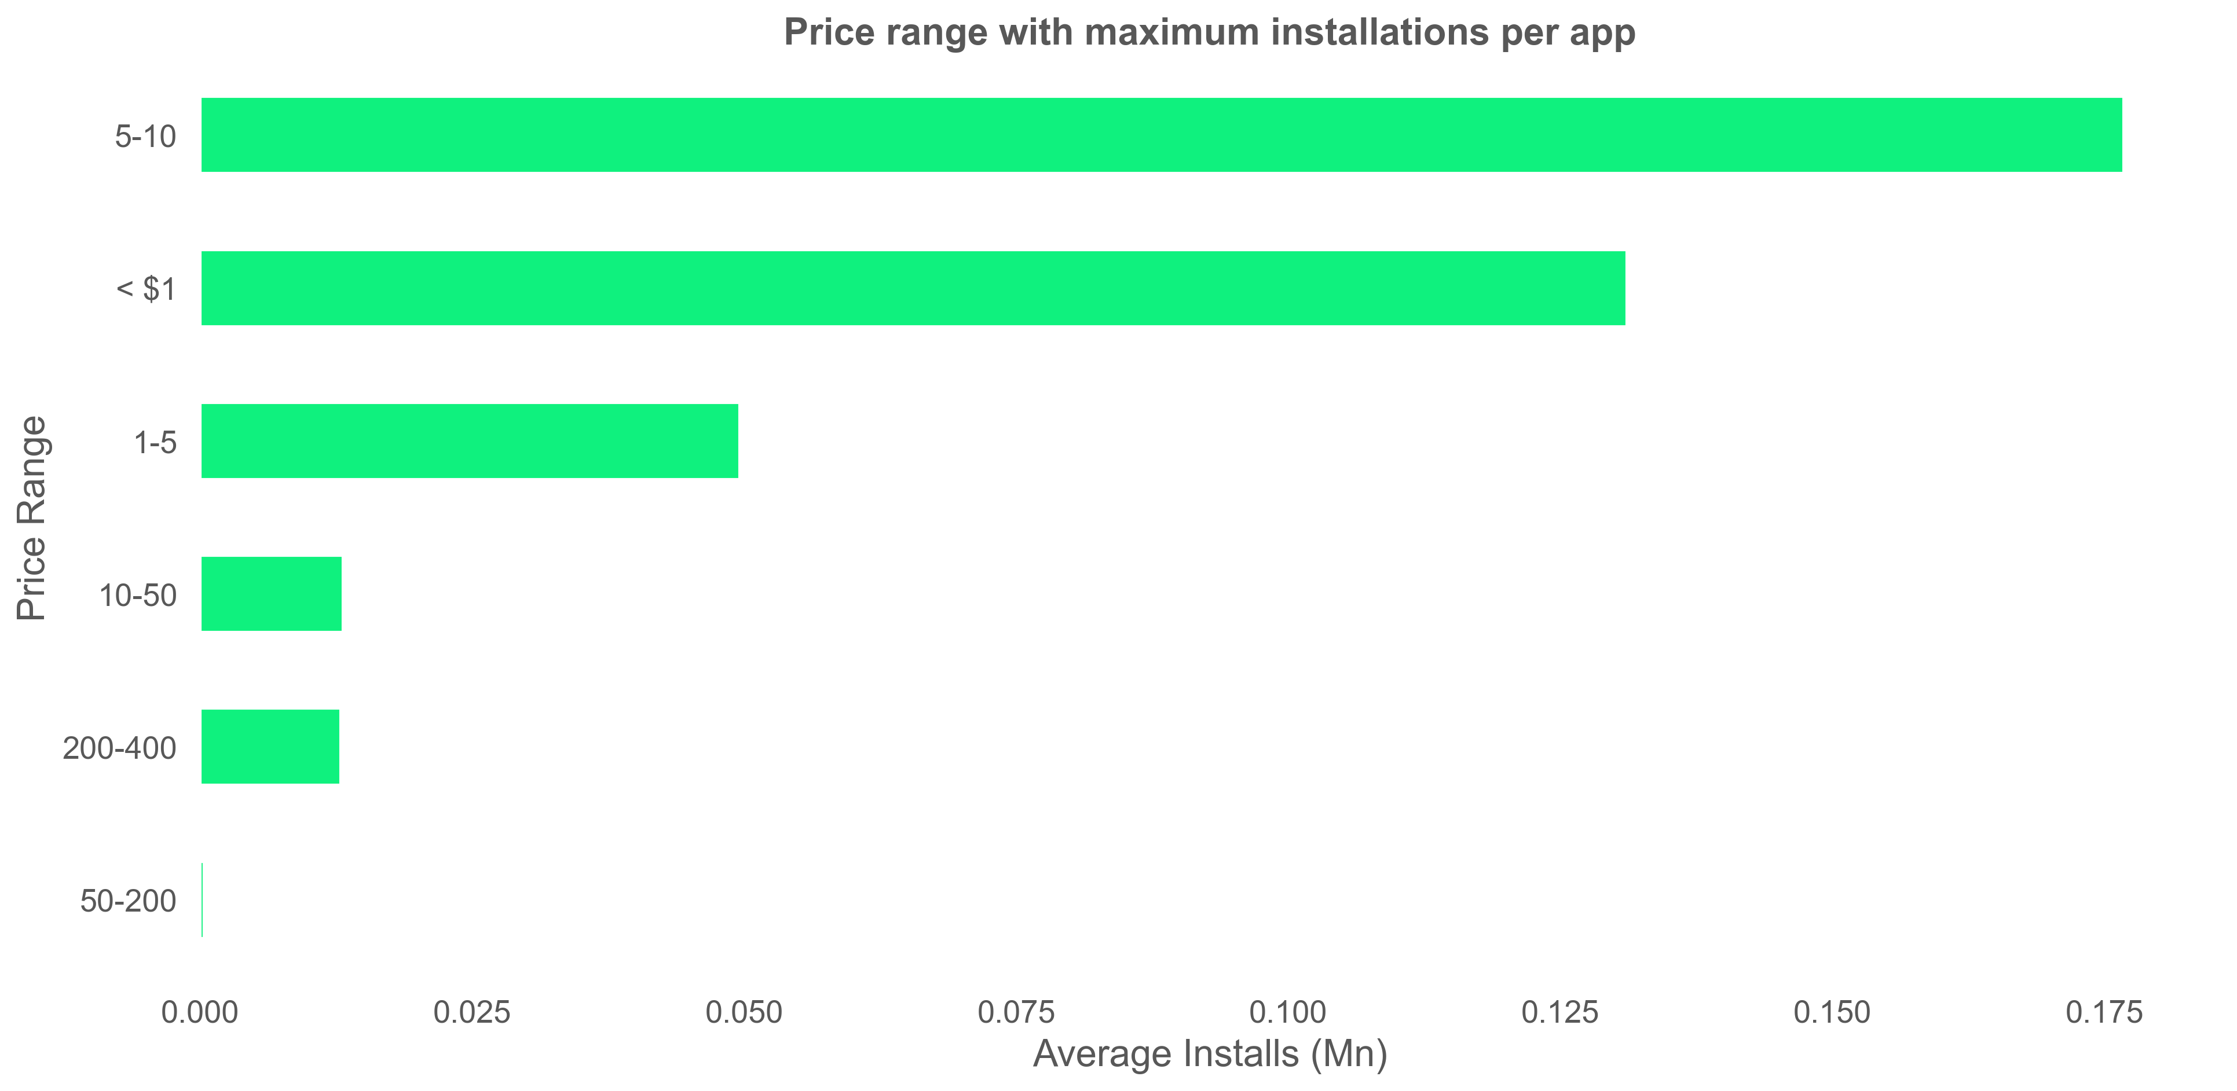

Slide 19
Conclusion
Category
Genre
Size
Content
Price
1
2
3
4
5
Communication, Game and Family
Action, Casual and Entertainment
Customary
<10 MB
Everyone
Free
Unexplored
Video Players
Sports
50 - 80 MB
Teen
$ 5 - 10
Subscription
Lifestyle and Finance
Action
90-100 MB
Everyone
$ 200 - 400

Slide 20
Thank You!

